Slide 1
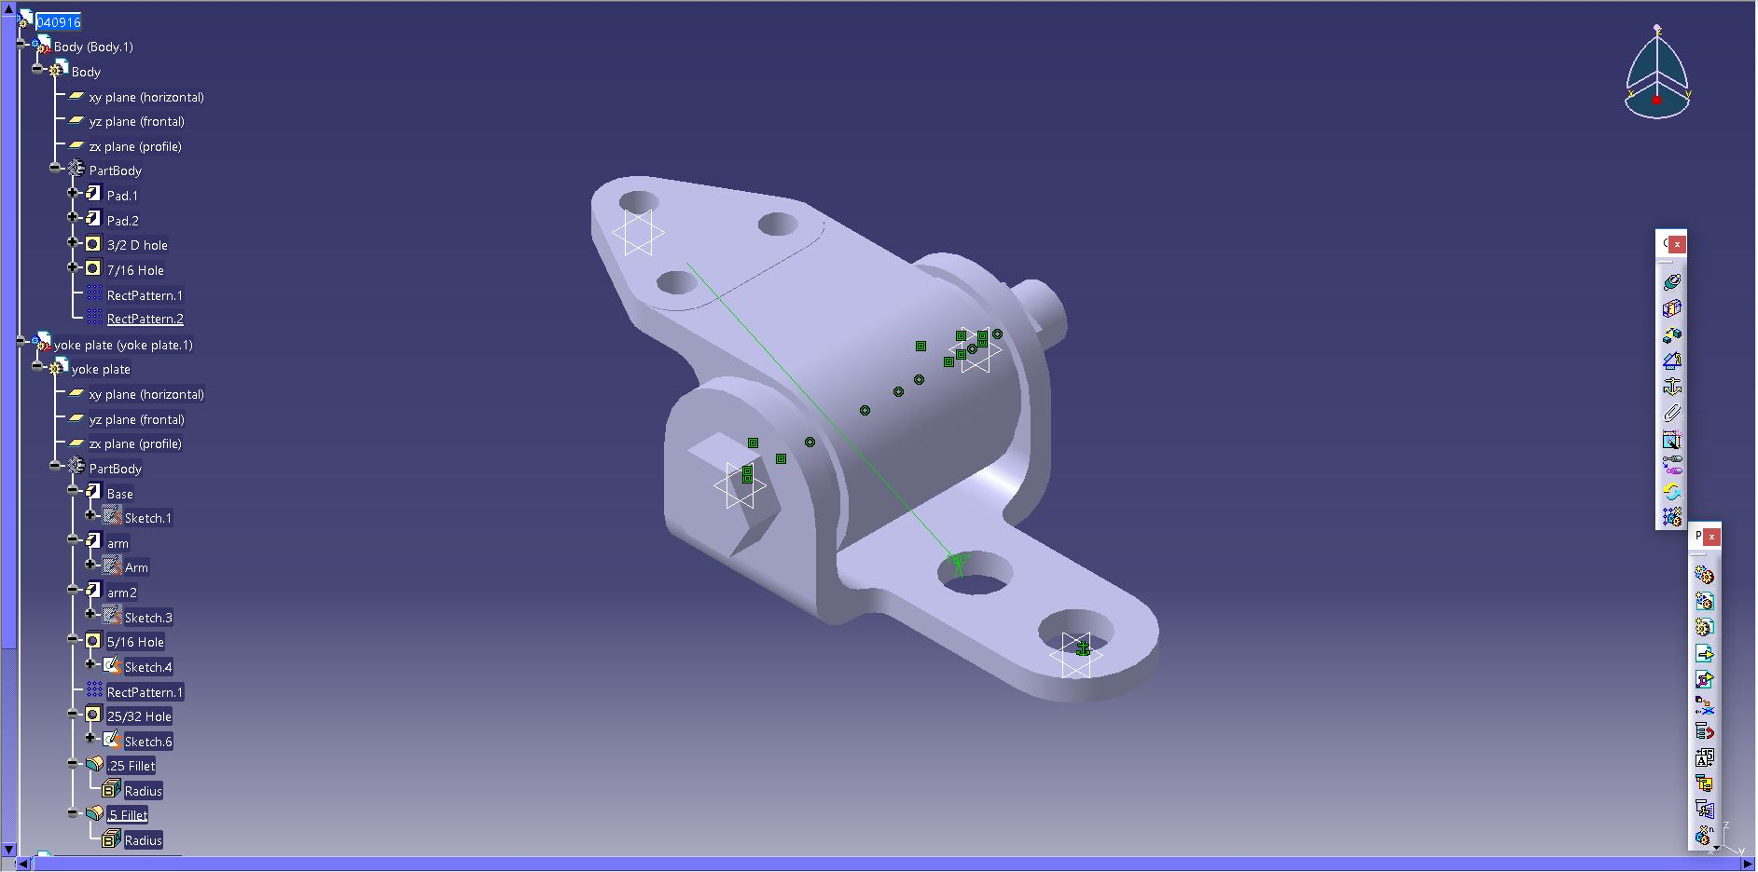
CGT 163 – GRAPHICAL COMMUNICATION & SPATIAL ANALYSIS
NAMITA MEKALA

Slide 2
GENERAL INFORMATION

Slide 3
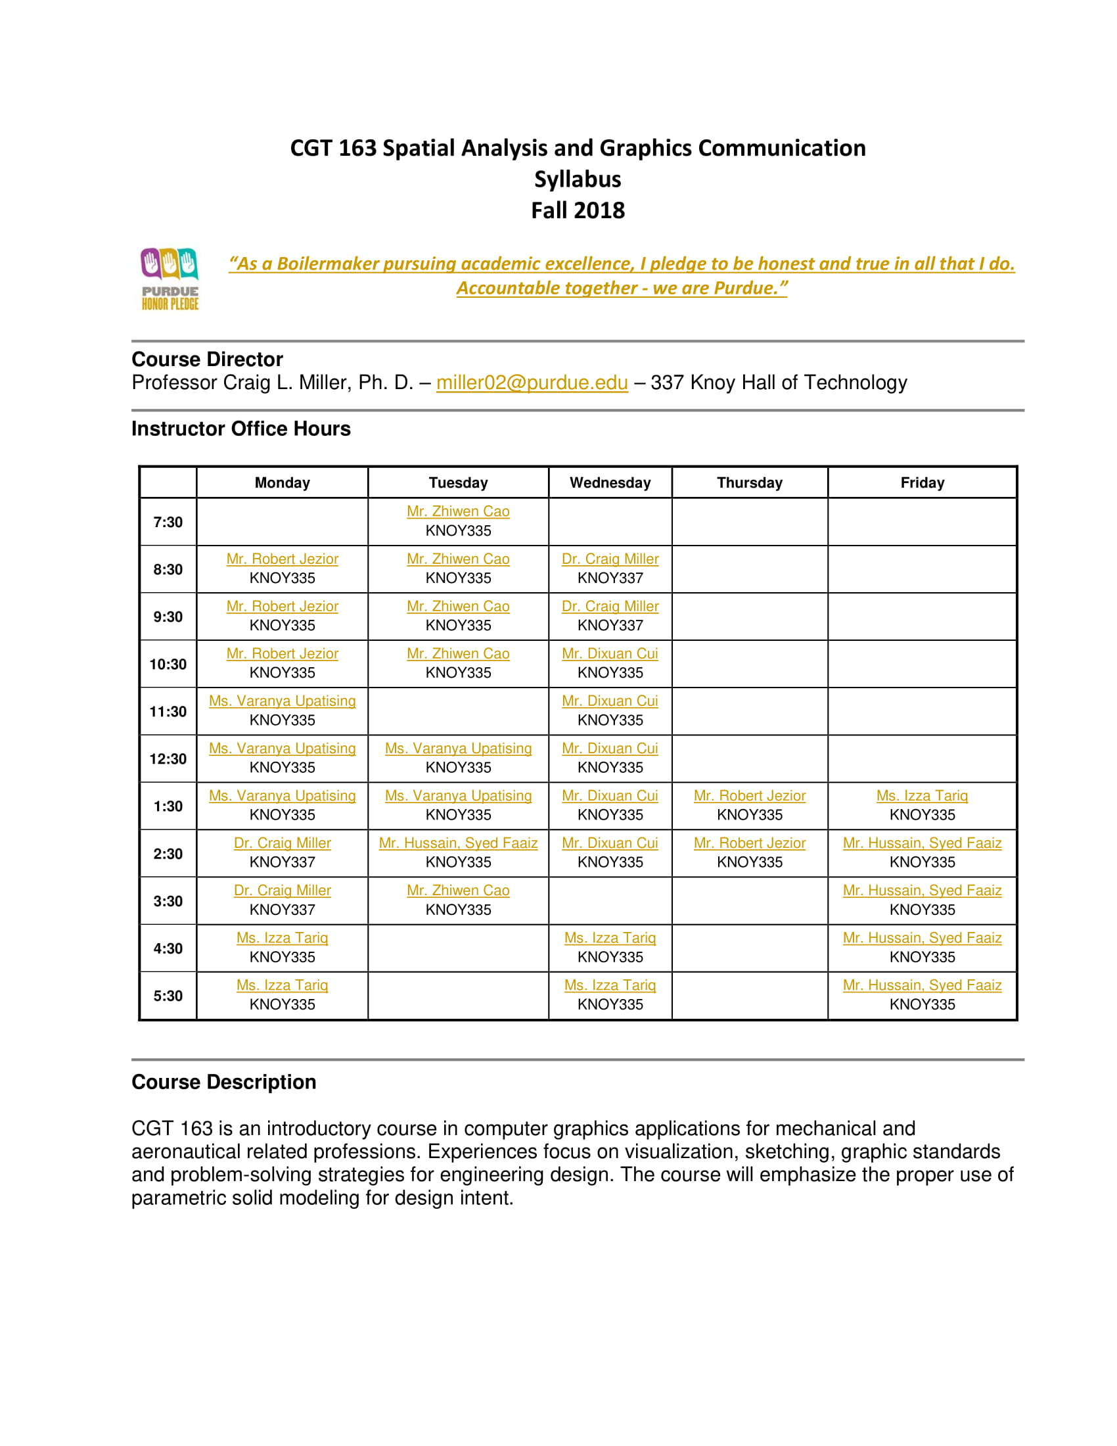

Slide 4


Slide 5
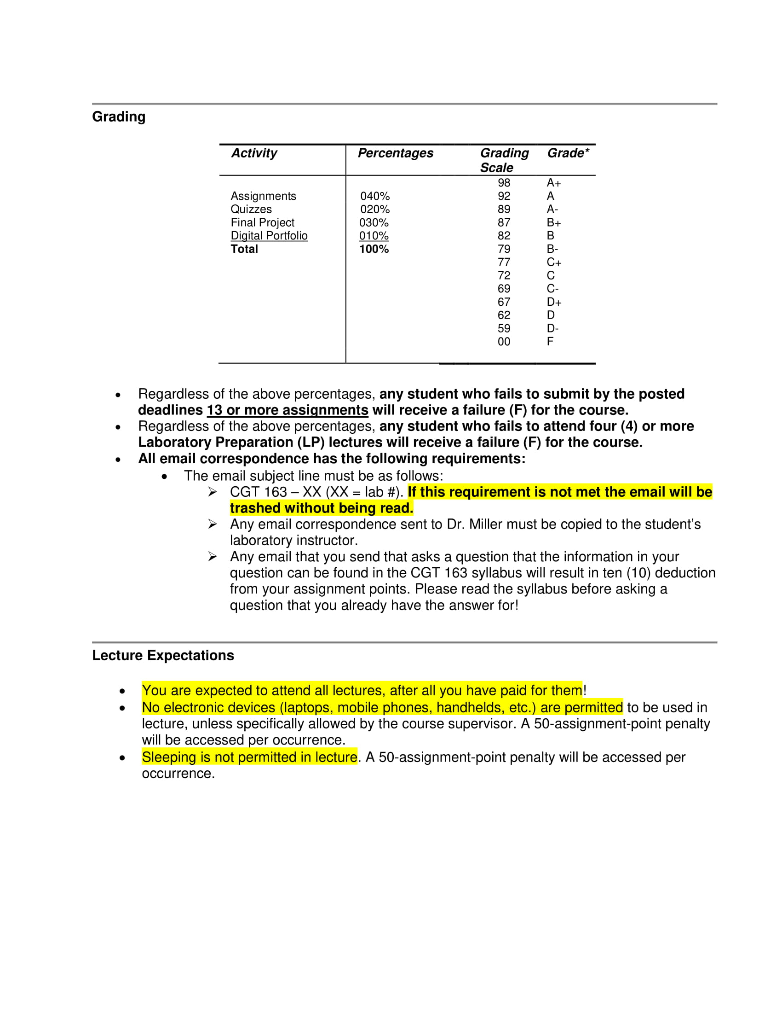

Slide 6
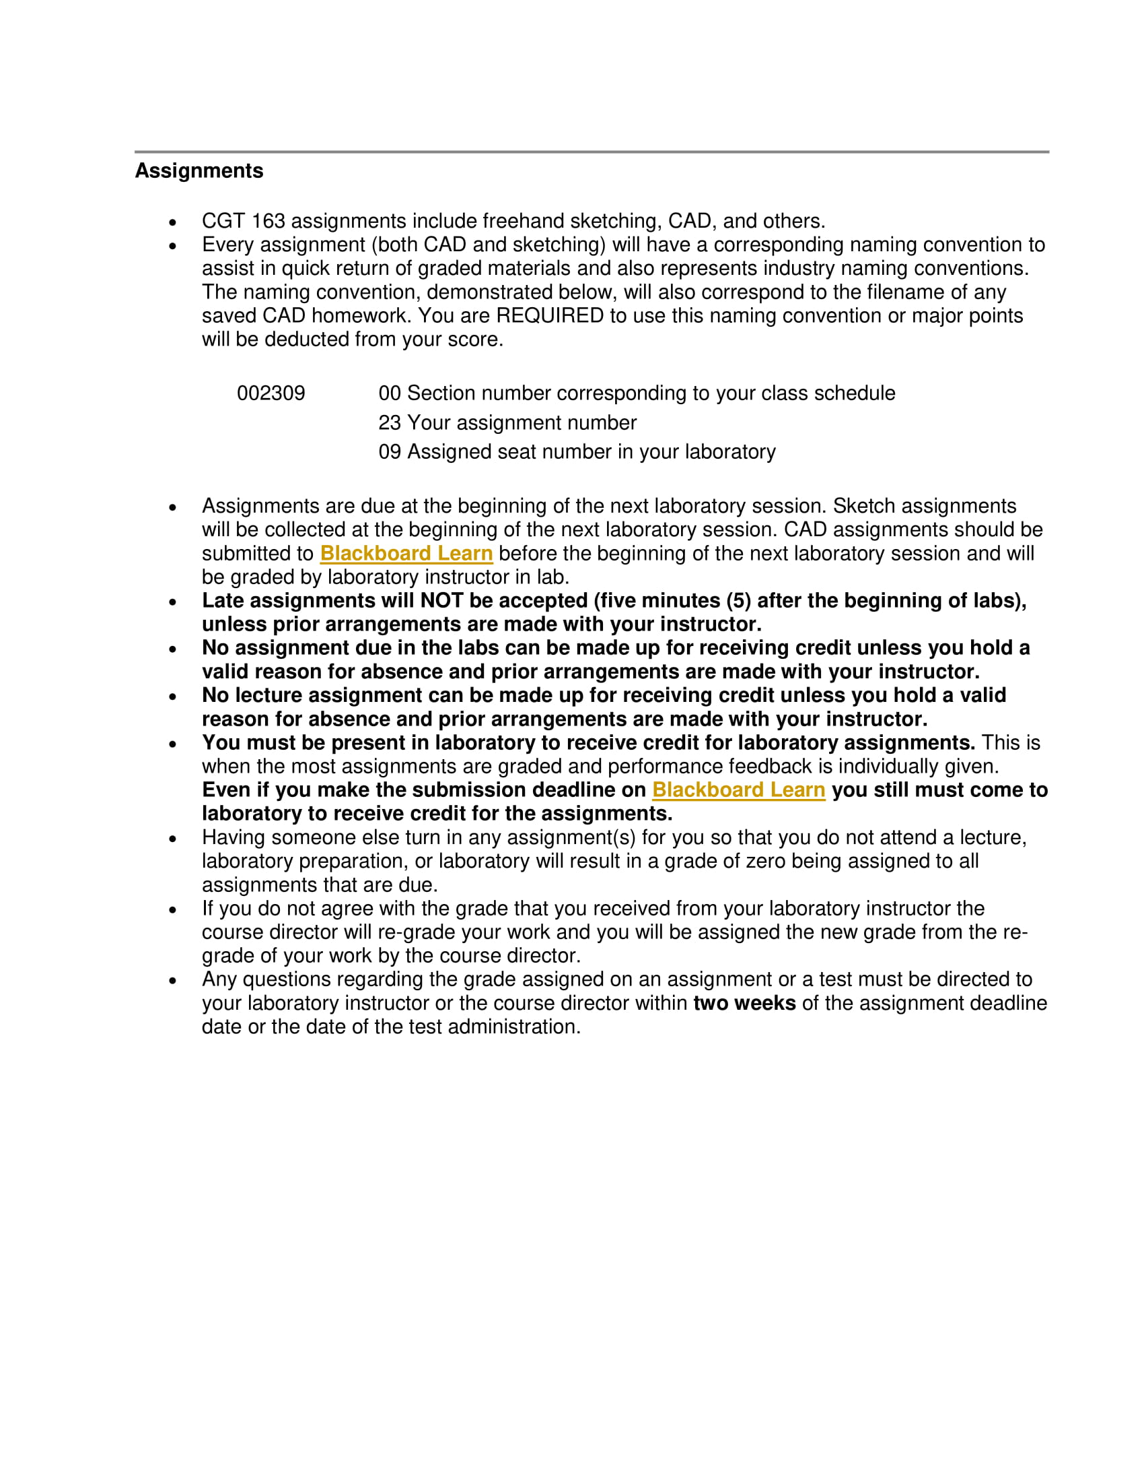

Slide 7
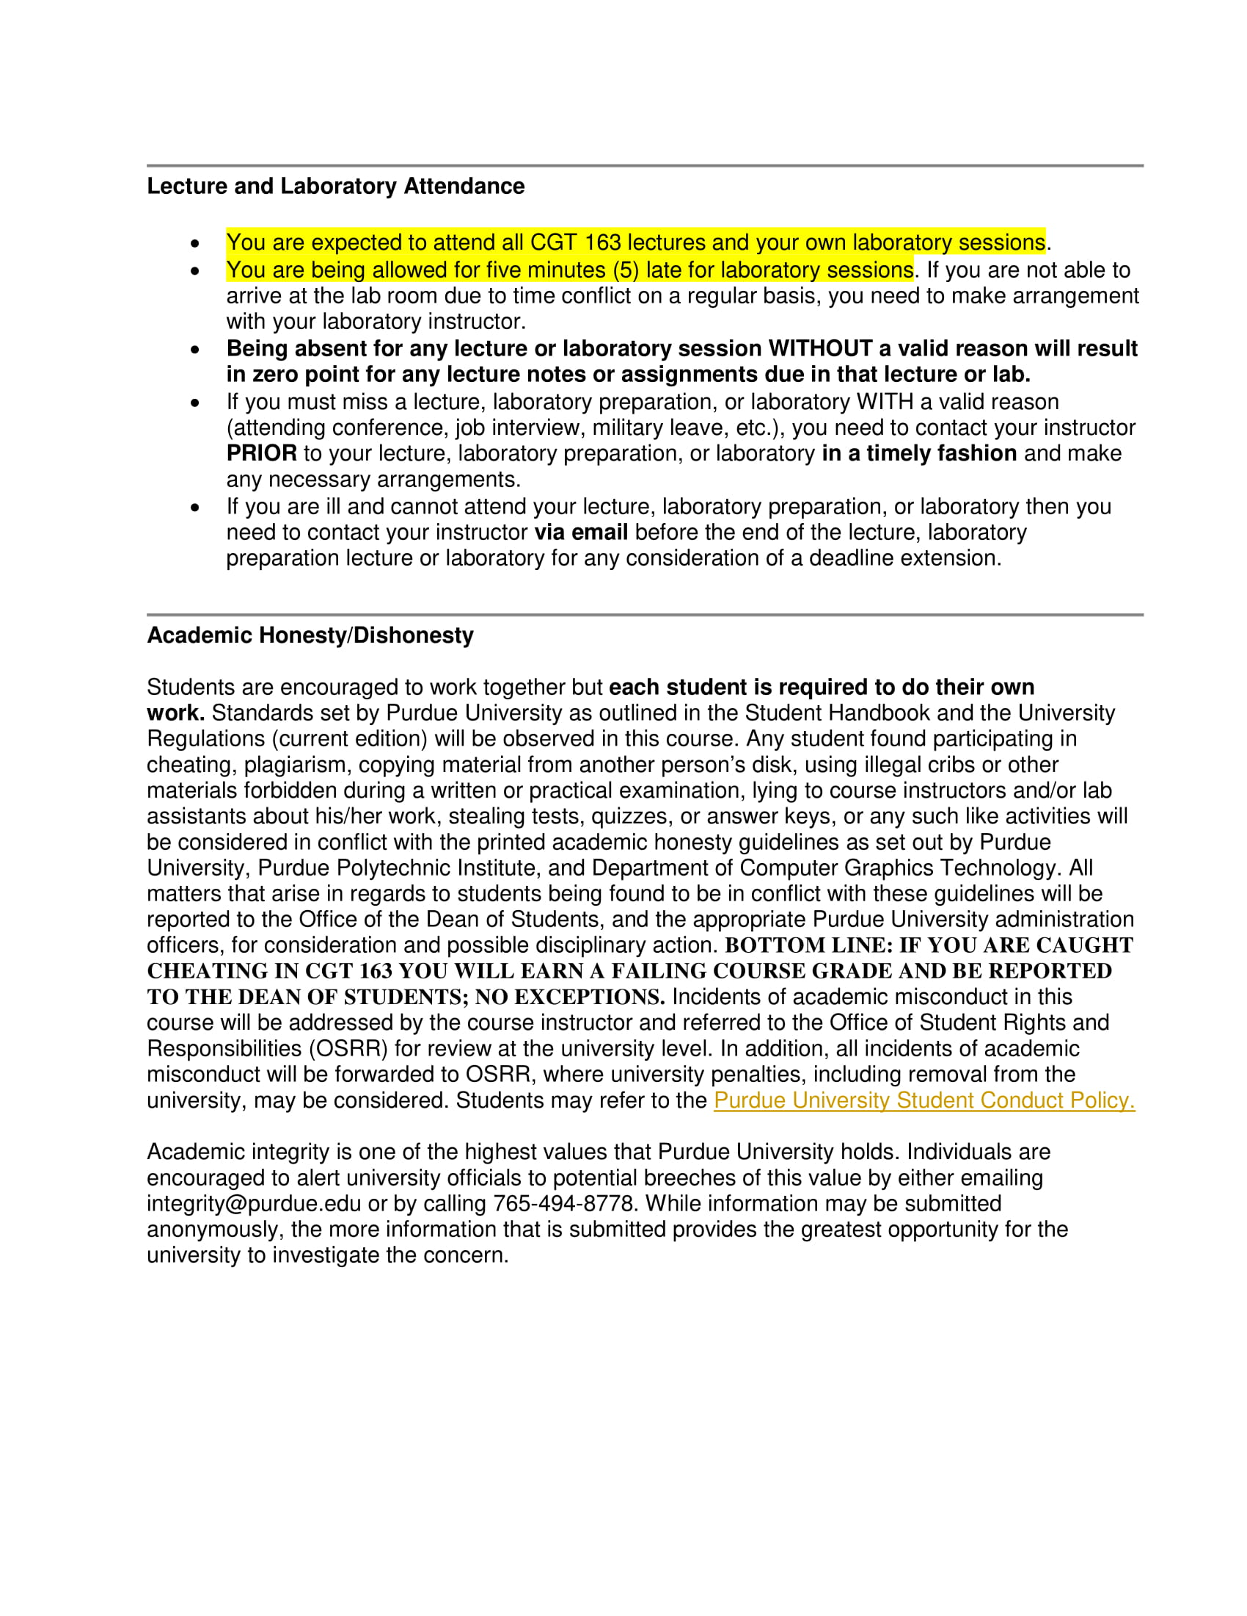

Slide 8
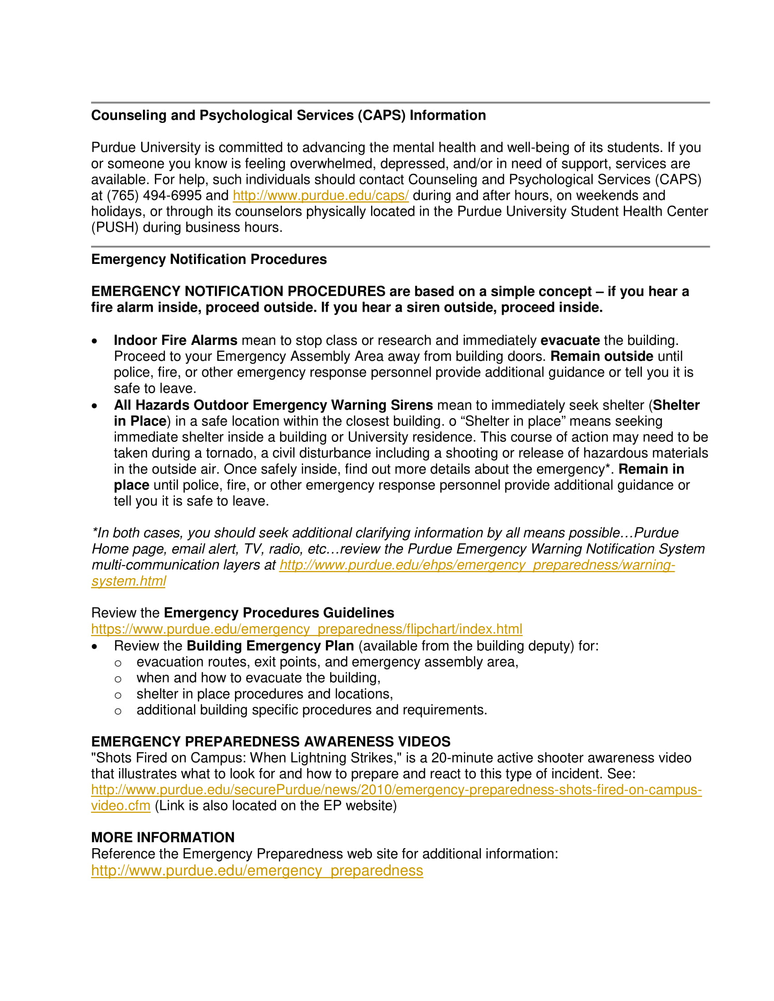

Slide 9
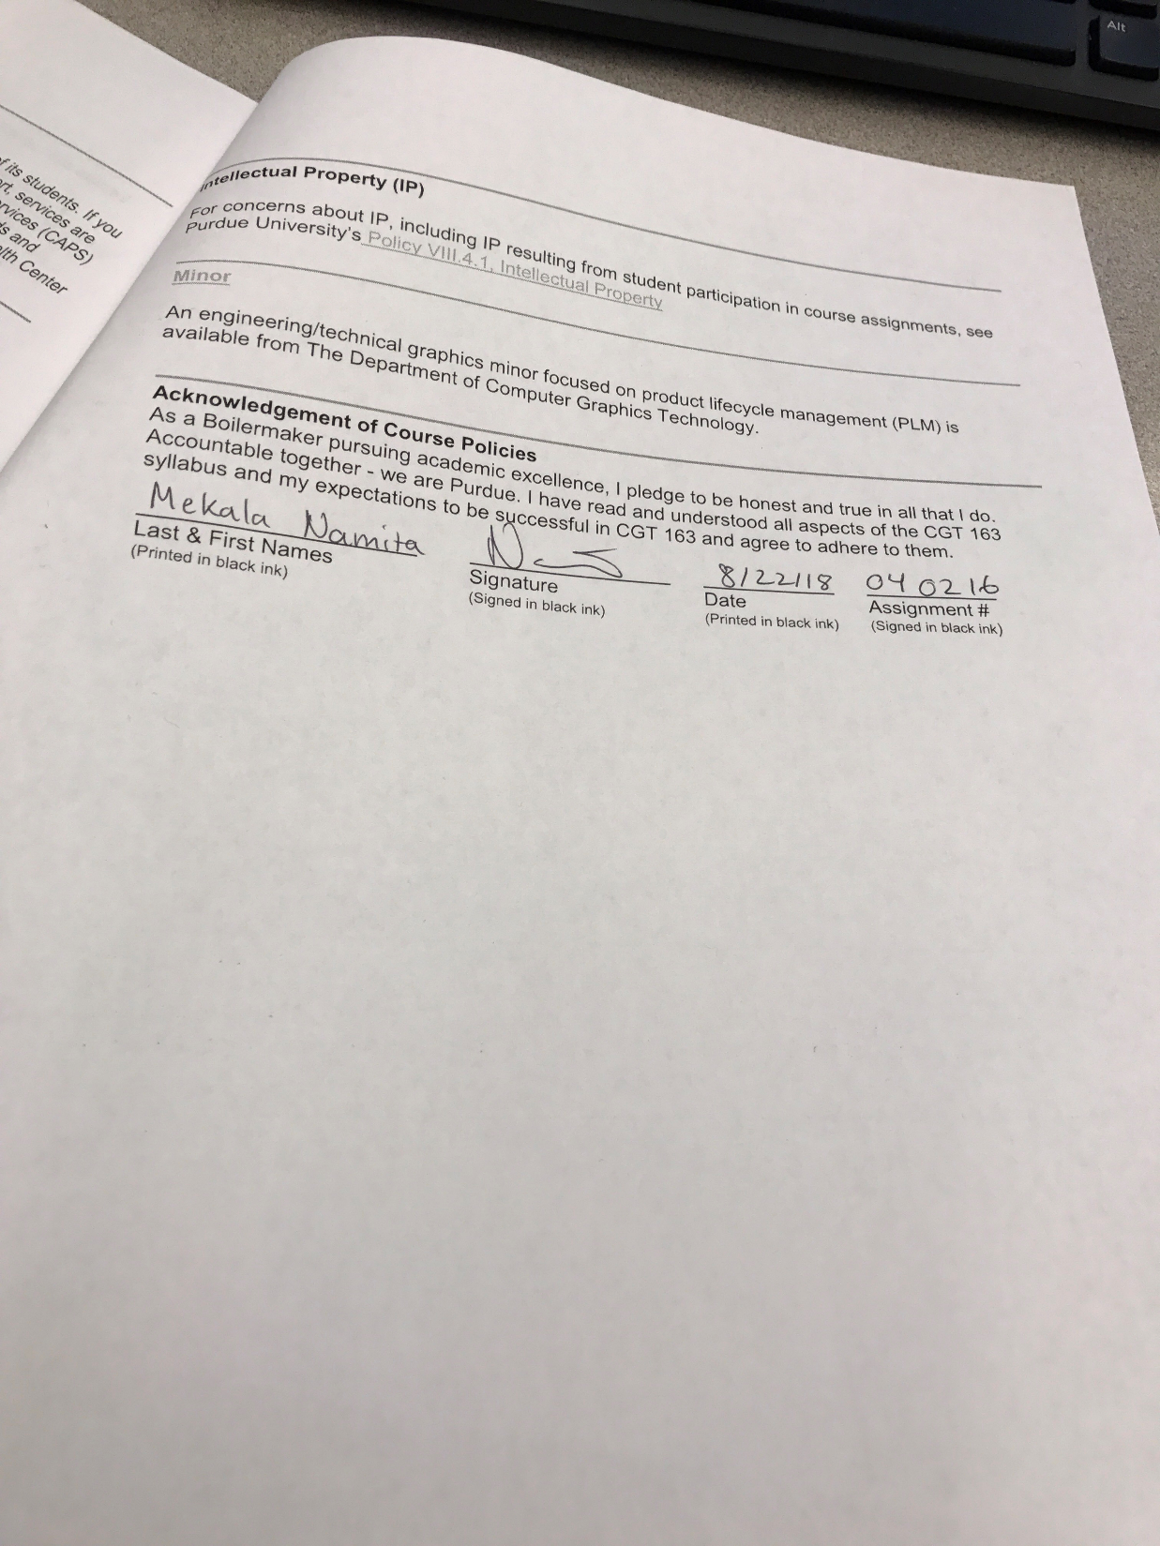

Slide 10
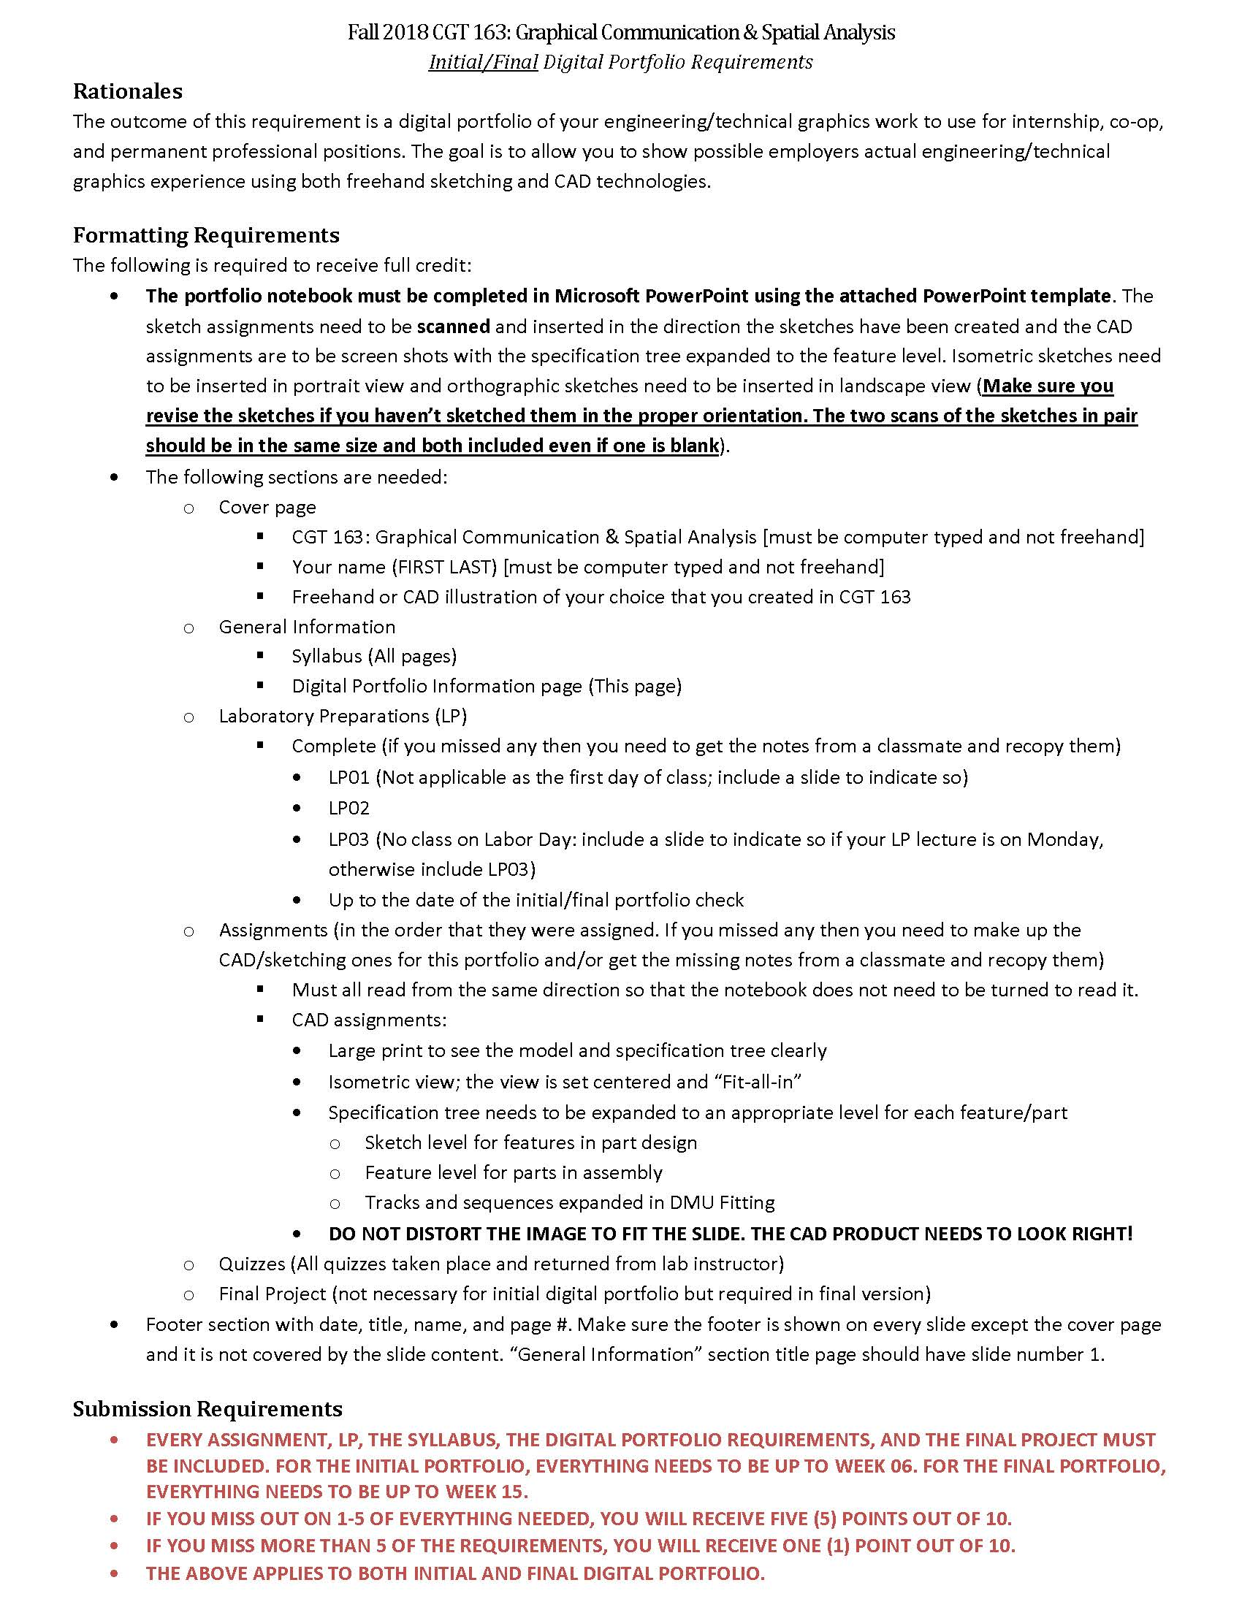

Slide 11
LABORATORY PREPARATIONS

Slide 12
04LP016
First day of the class

Slide 13
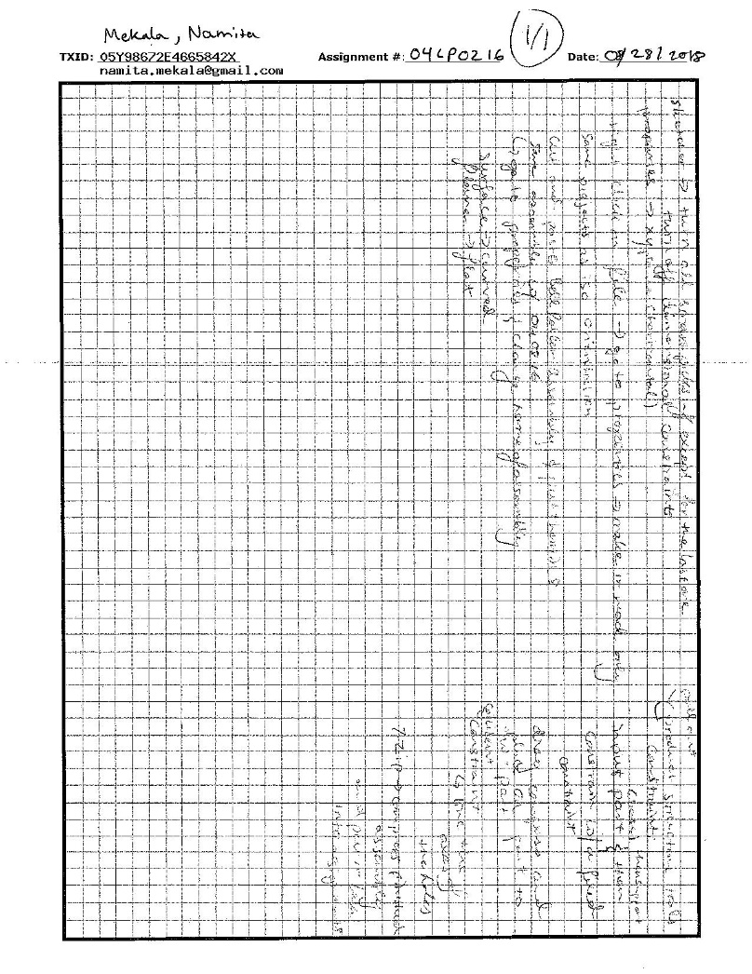
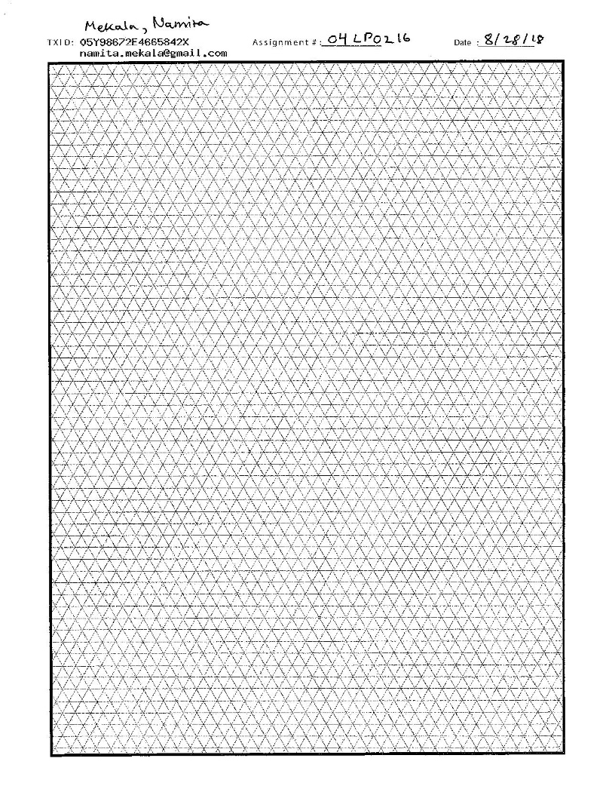
04LP0216

Slide 14
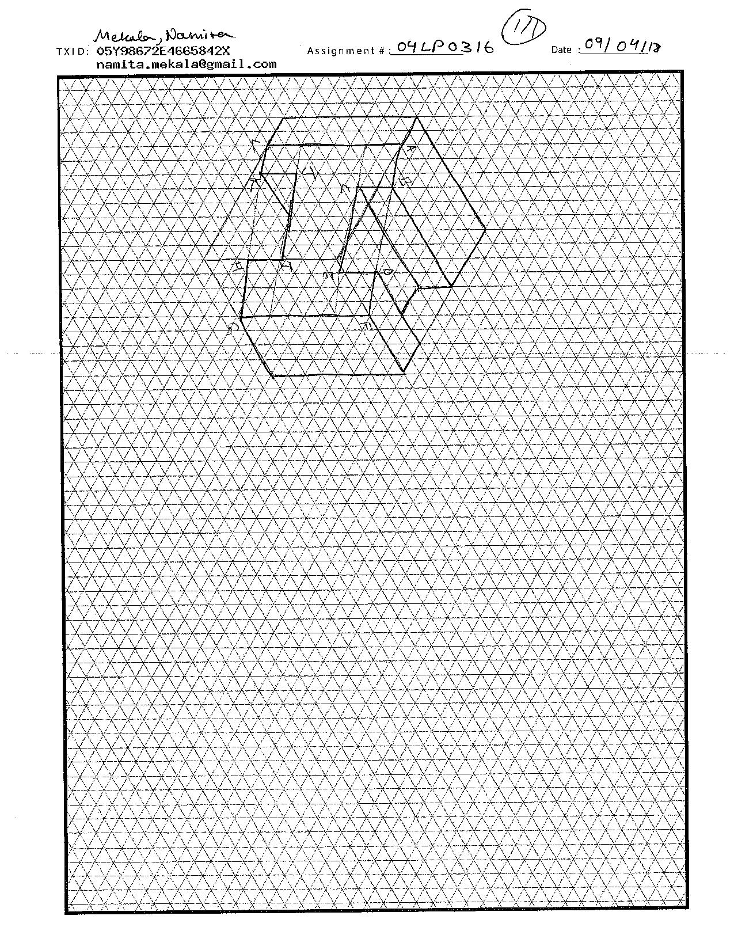
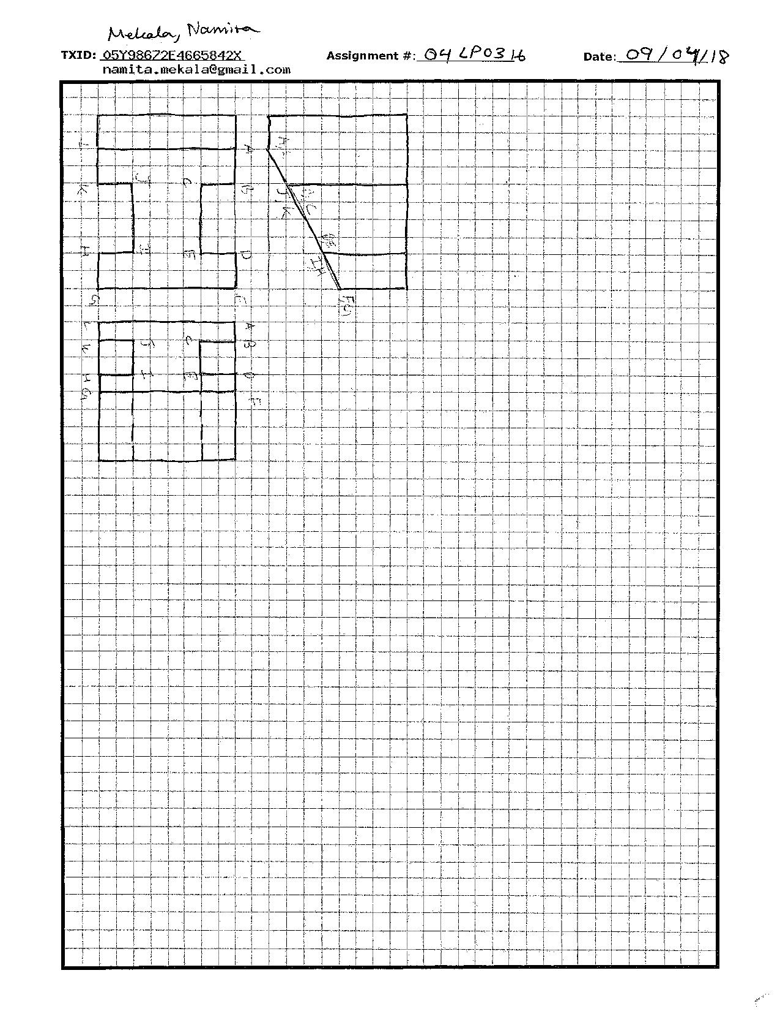
04LP0316

Slide 15
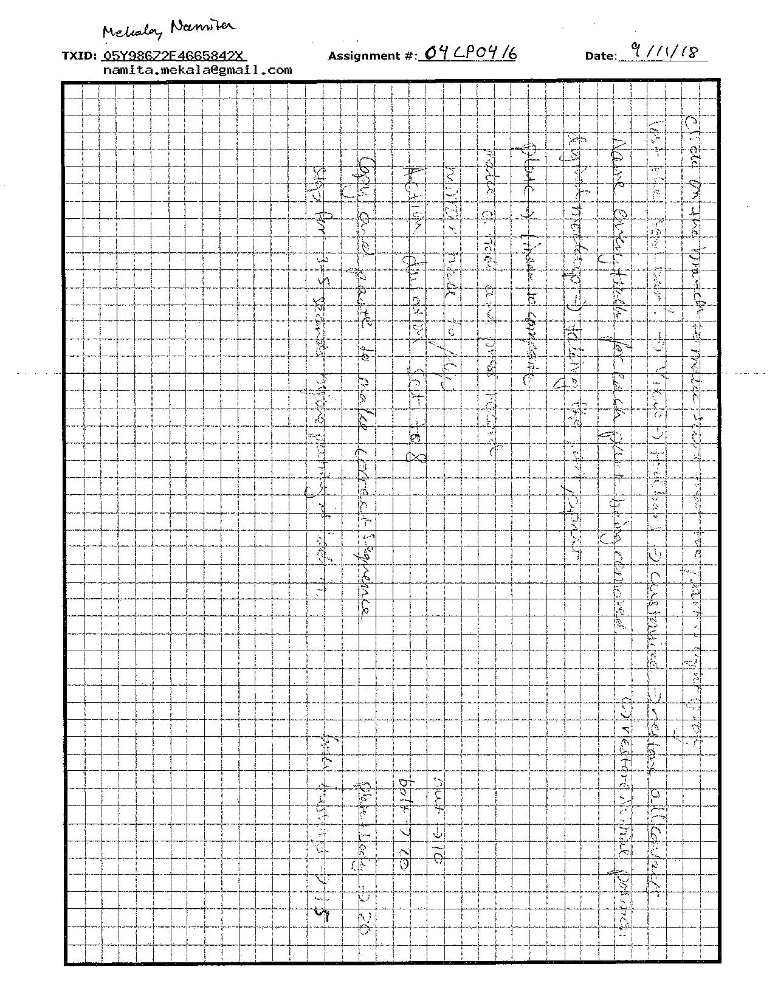
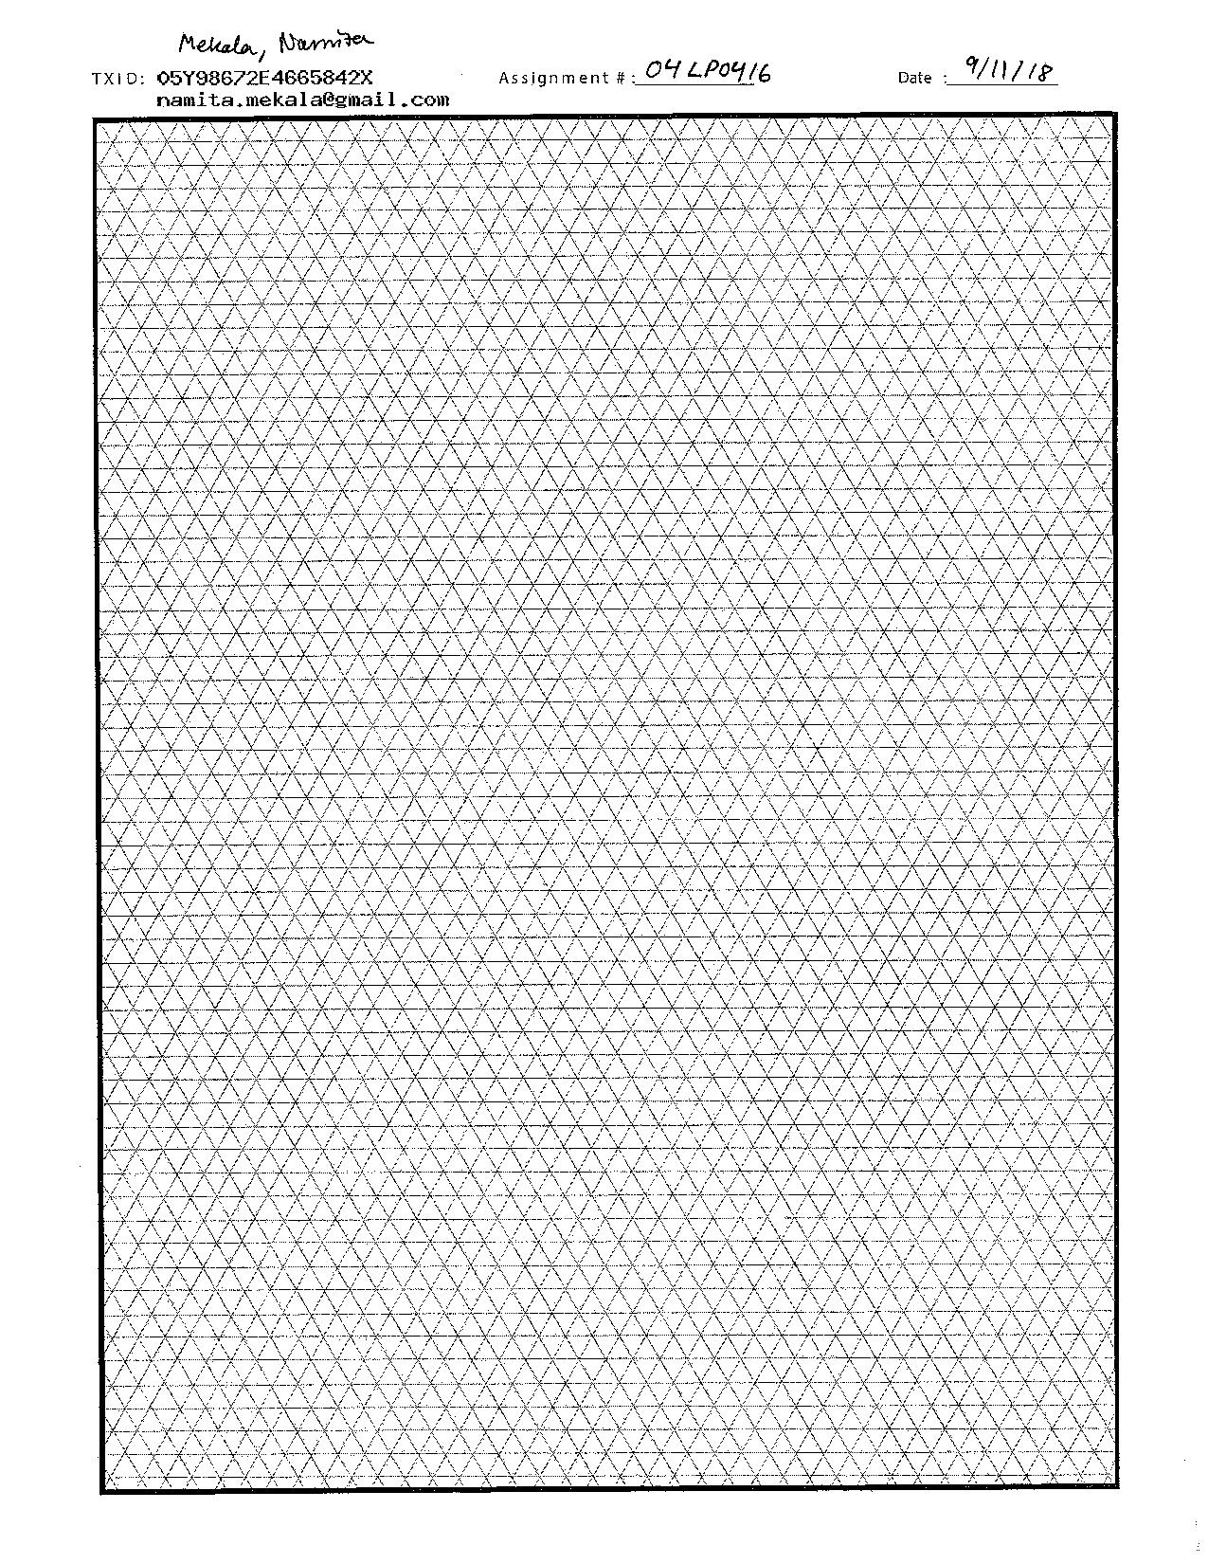
04LP0416

Slide 16
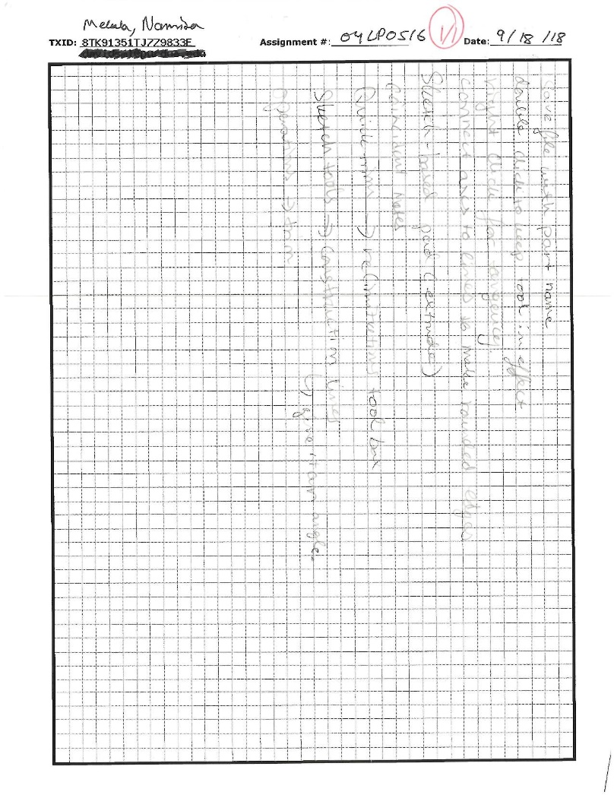
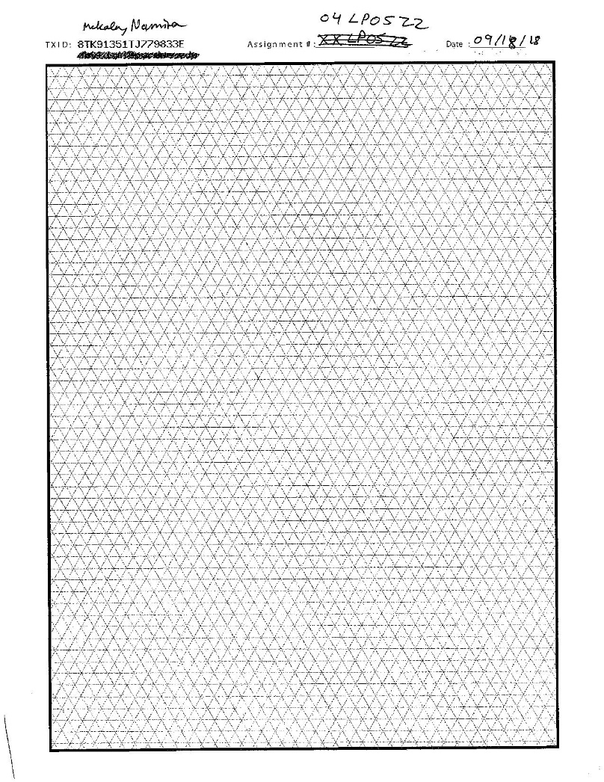
04LP0516

Slide 17
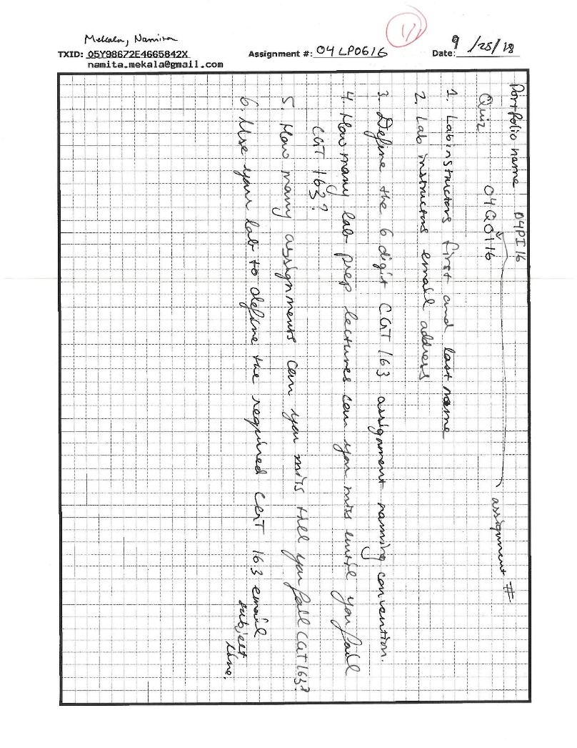
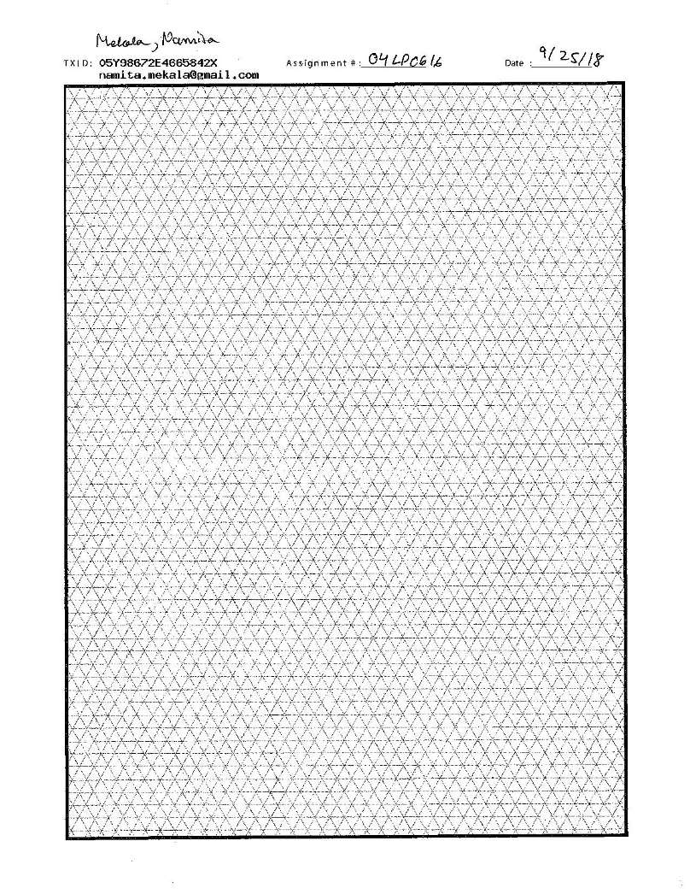
04LP0616

Slide 18
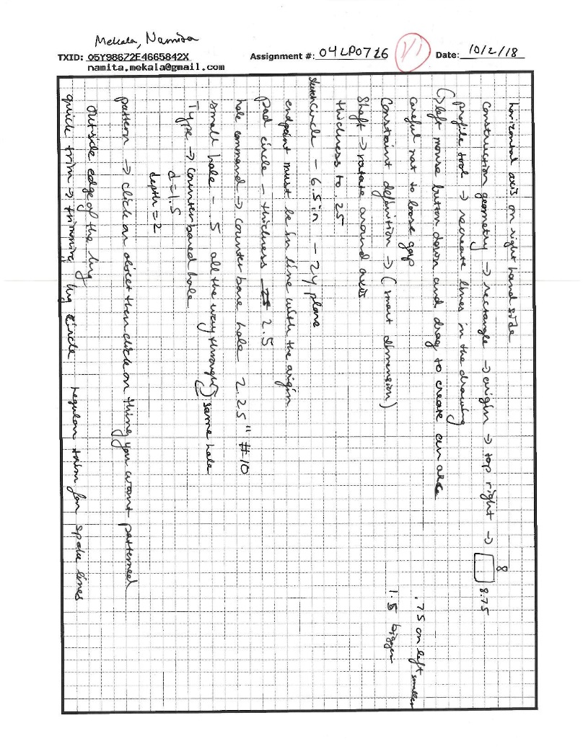
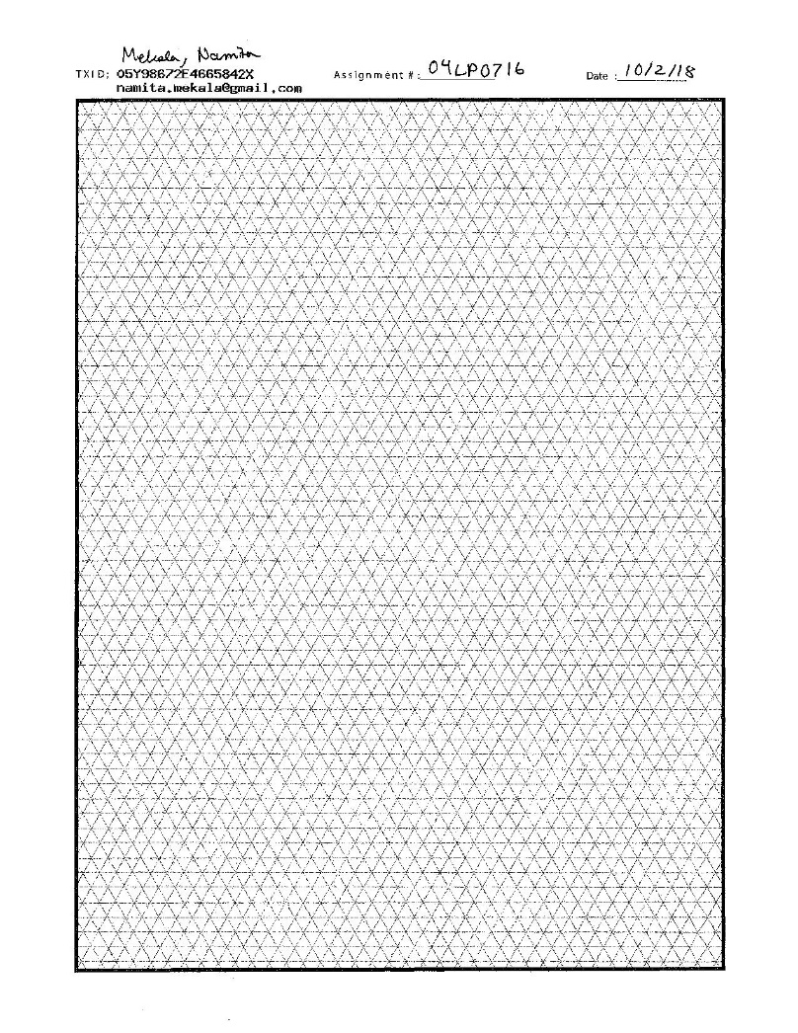
04LP0716

Slide 19
04LP0816
No Lecture Notes

Slide 20
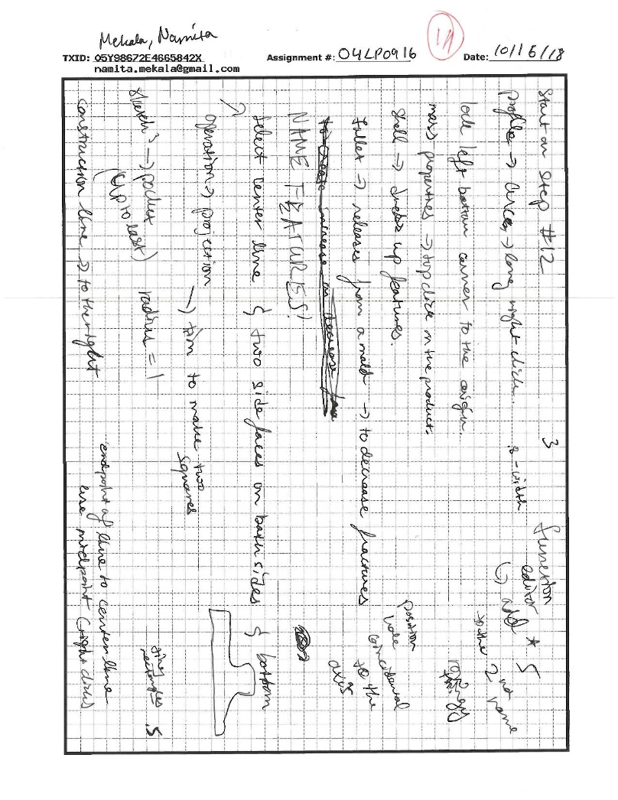
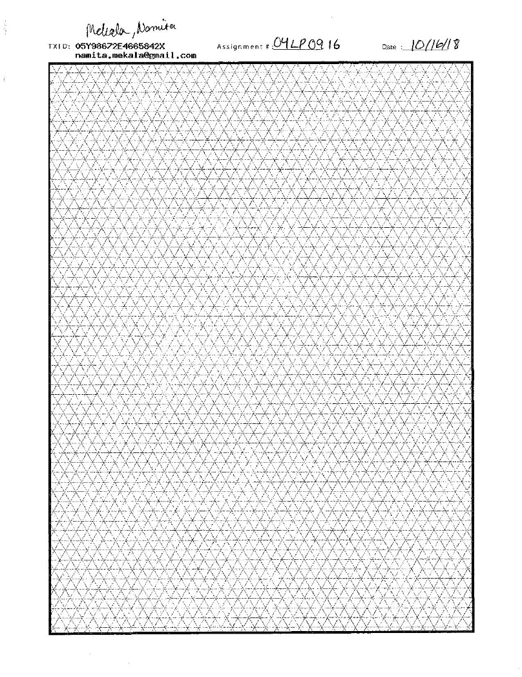
04LP0916

Slide 21
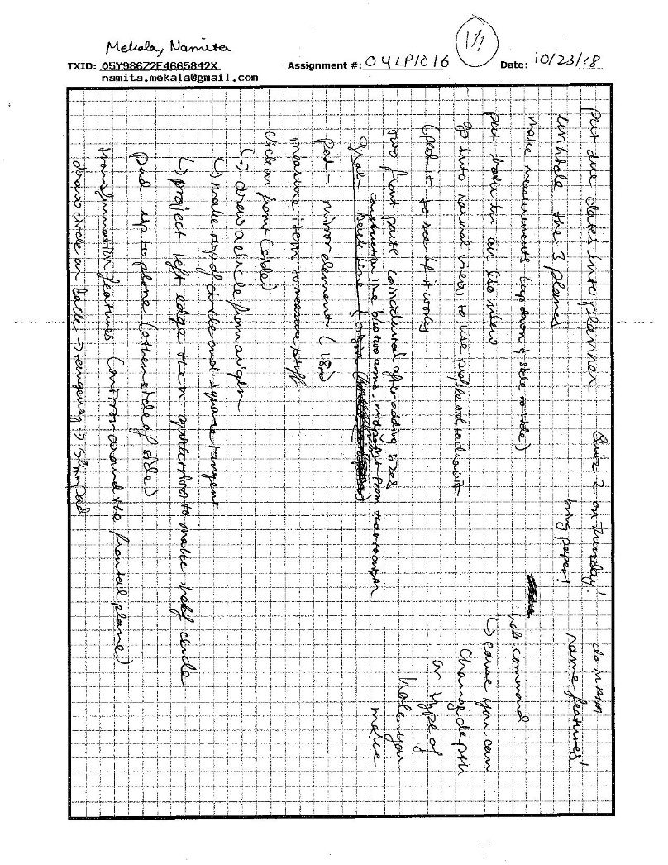
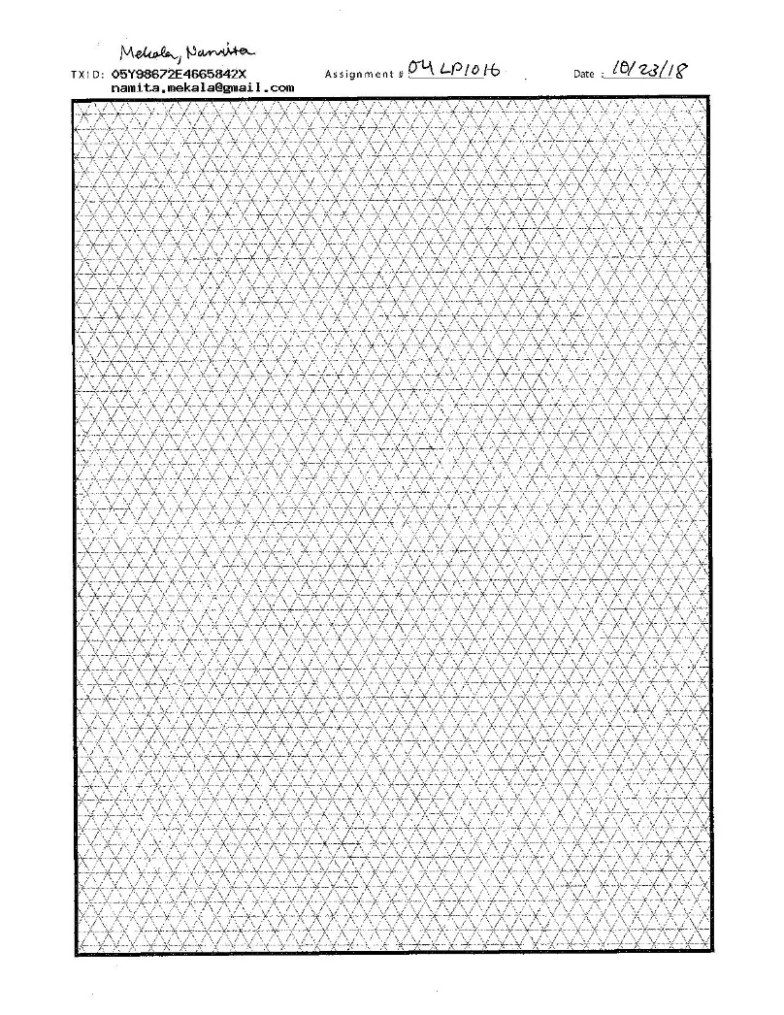
04LP1016

Slide 22
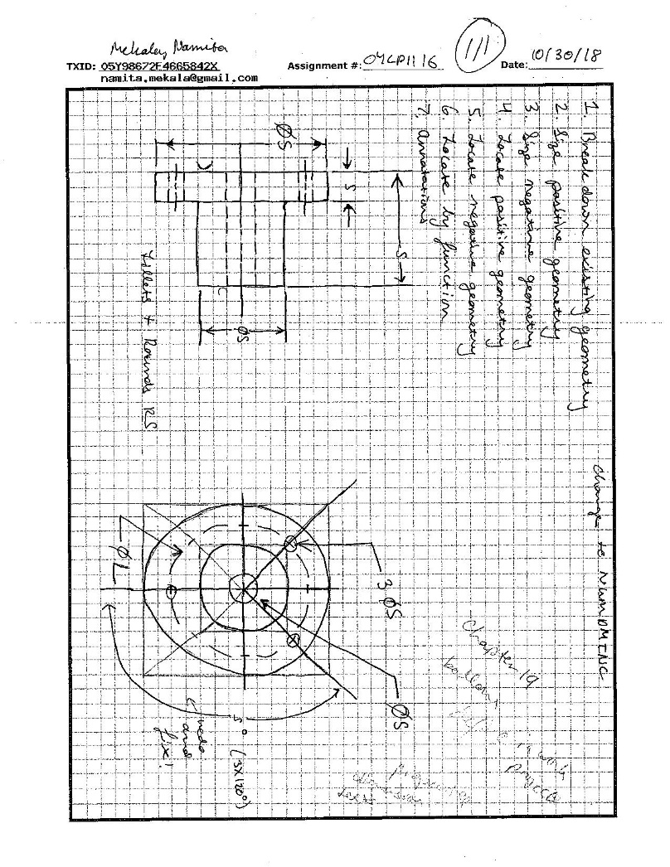
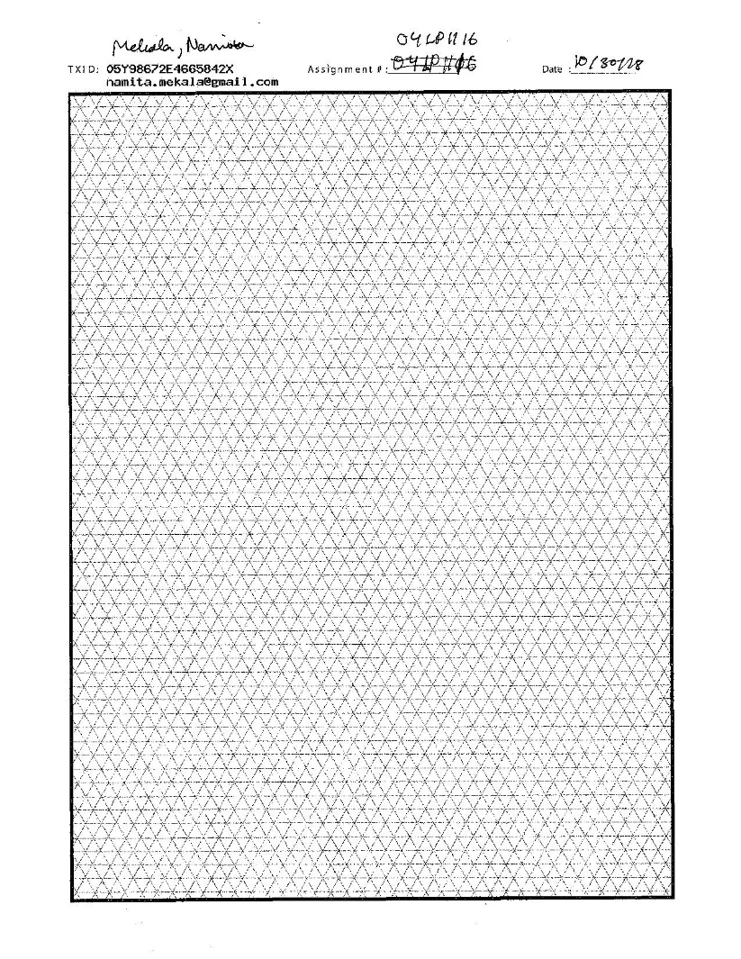
04LP1116

Slide 23
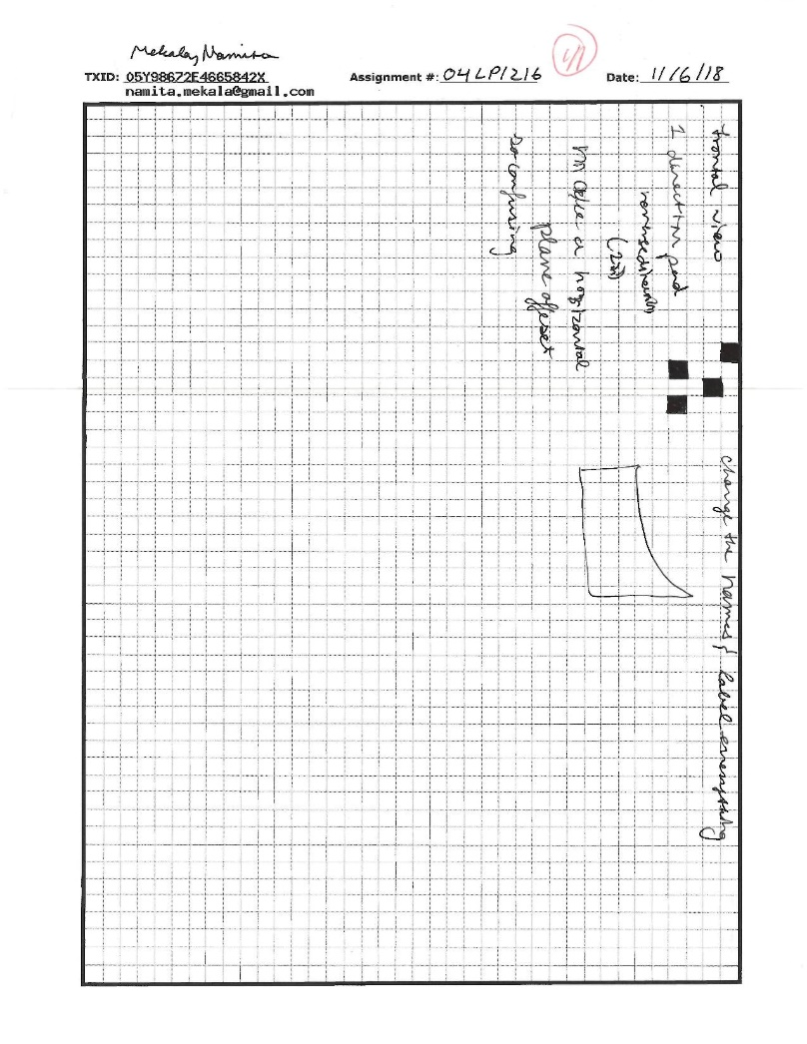
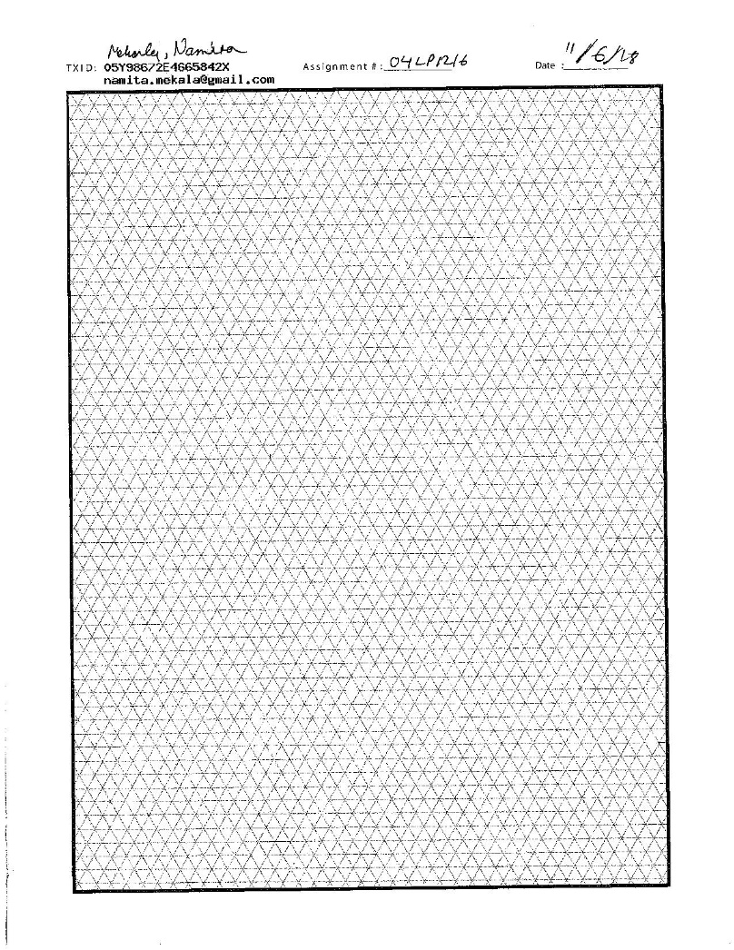
04LP1216

Slide 24
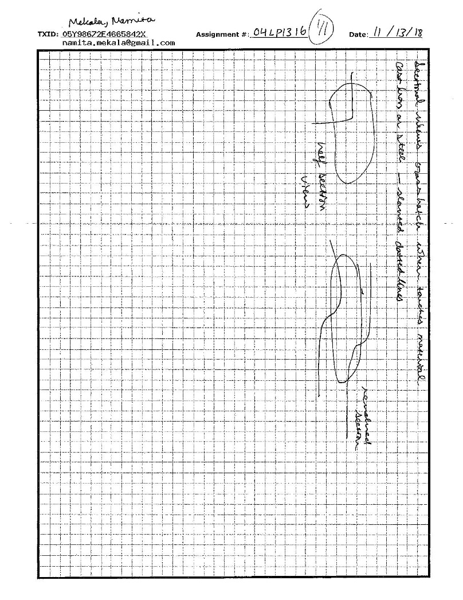
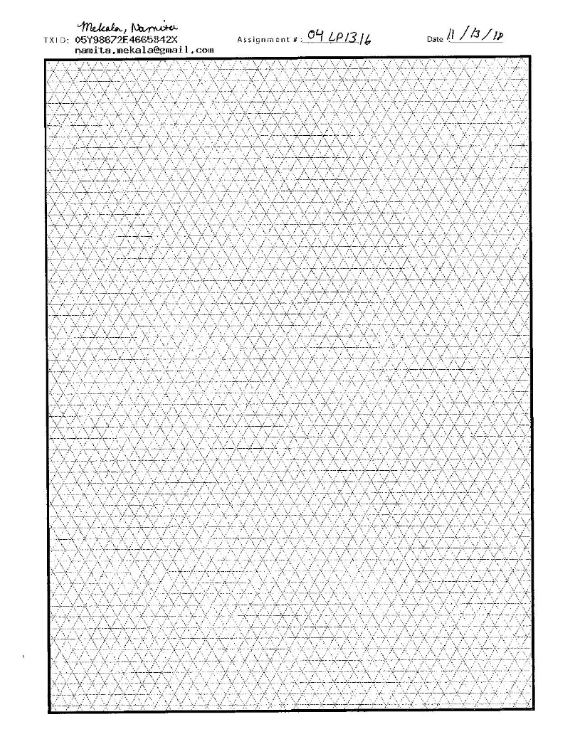
04LP1316

Slide 25
04LP1416
N/A

Slide 26
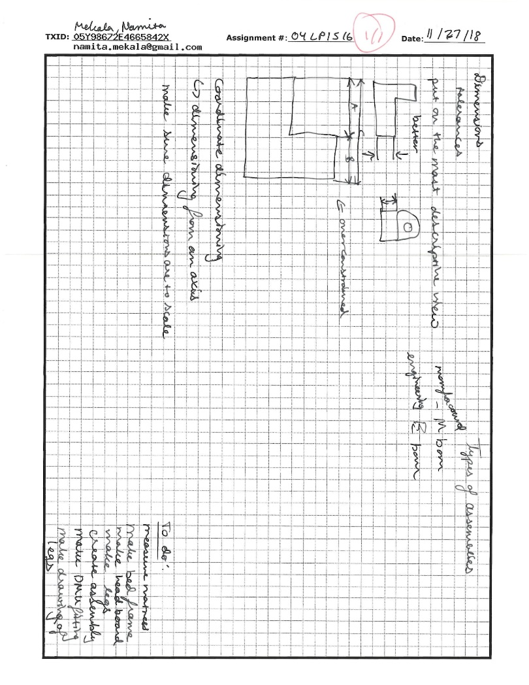

04LP1516

Slide 27
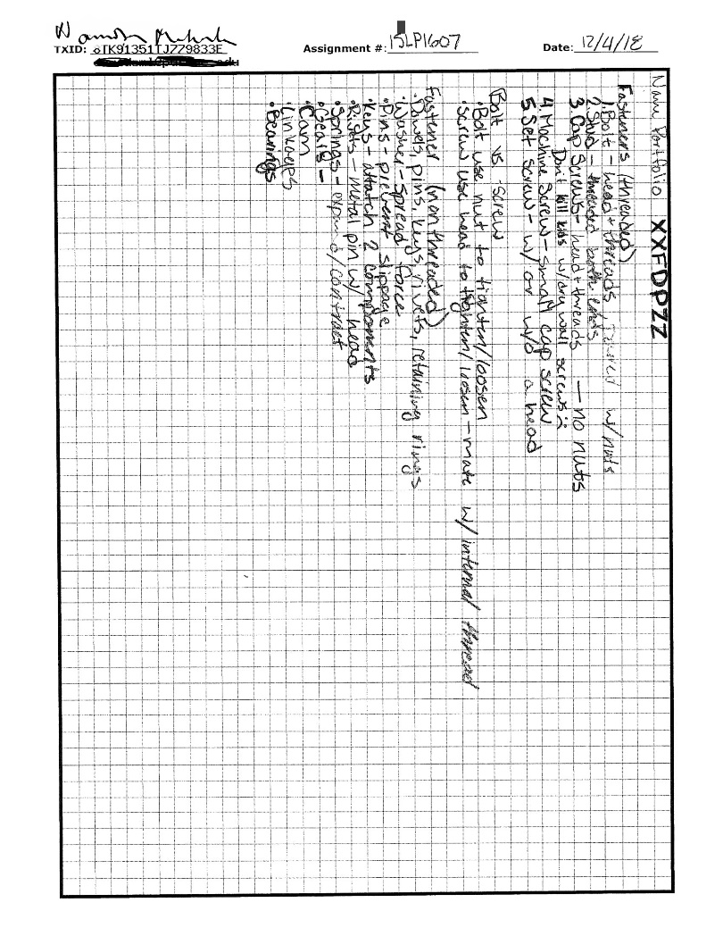

04LP1616

Slide 28
ASSIGNMENTS

Slide 29
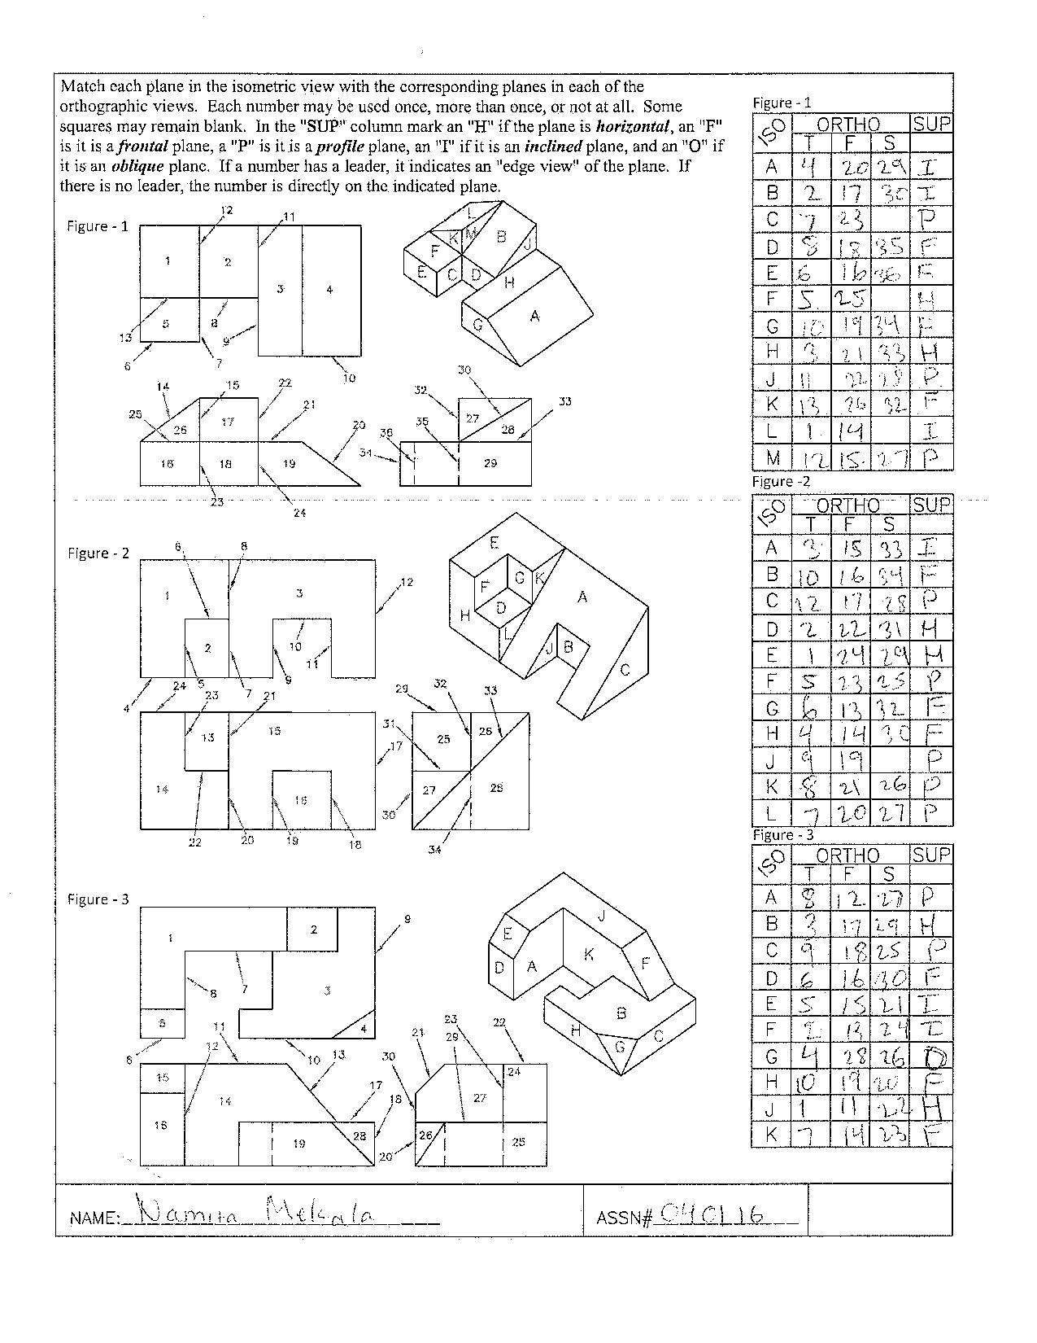

040116 – Plane Identification

Slide 30
040216 – CGT163 Syllabus
SEE GENERAL INFORMATION SECTION

Slide 31

040316 – Course Questionnaire

Slide 32
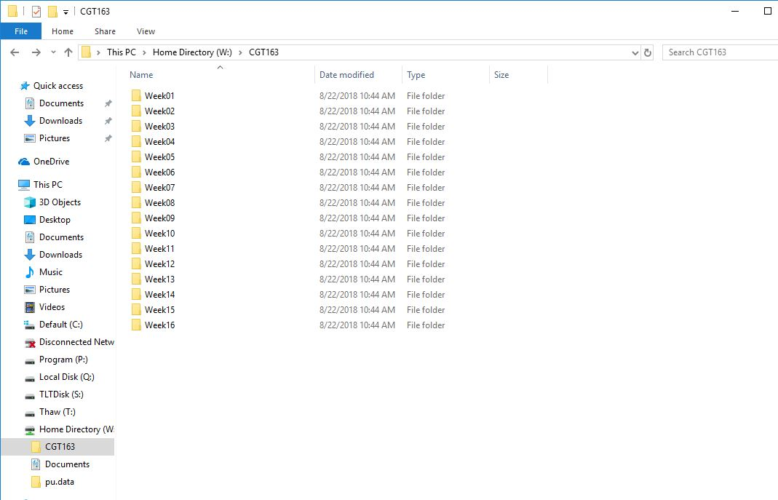
040416

Slide 33
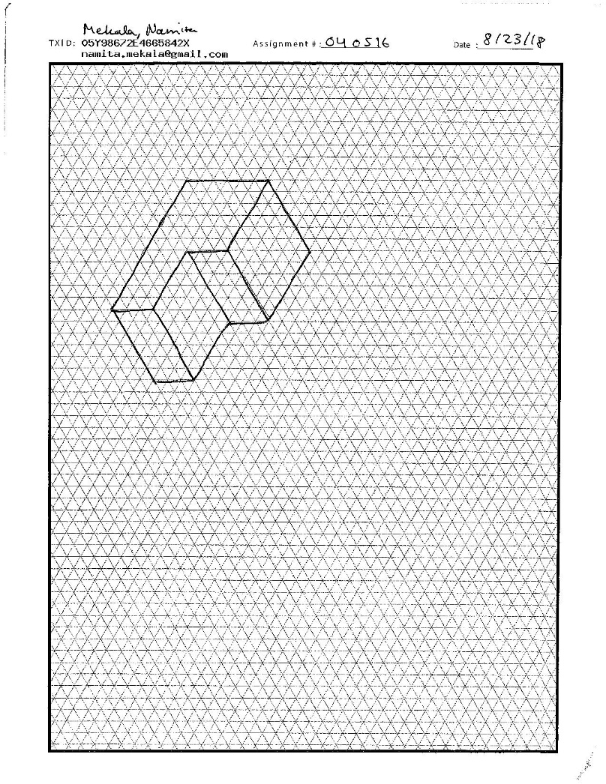
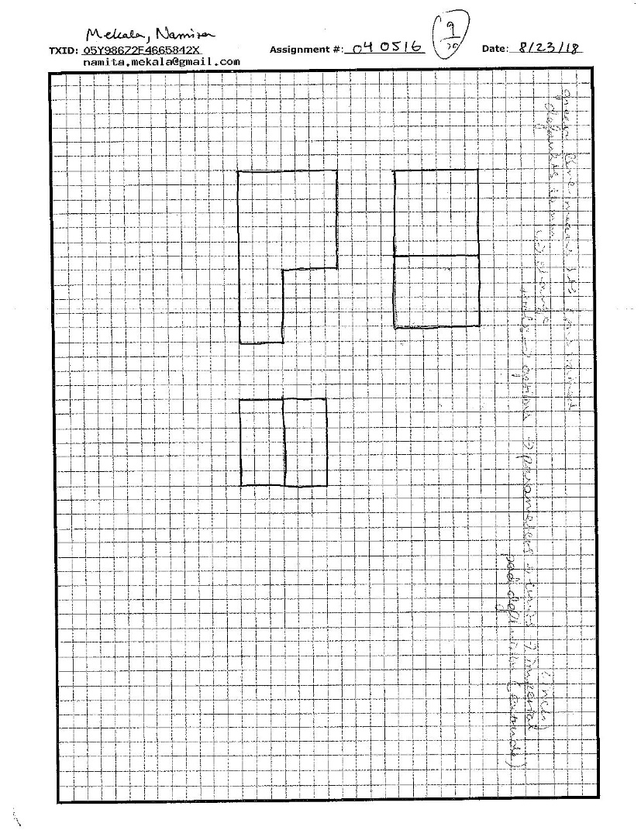
040516

Slide 34
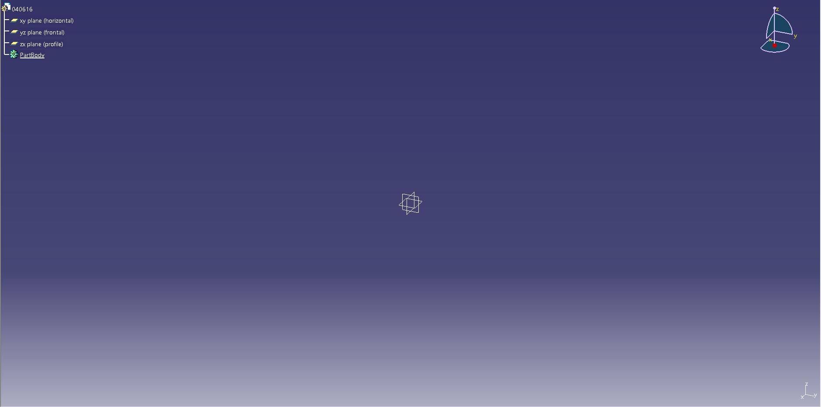
040616

Slide 35
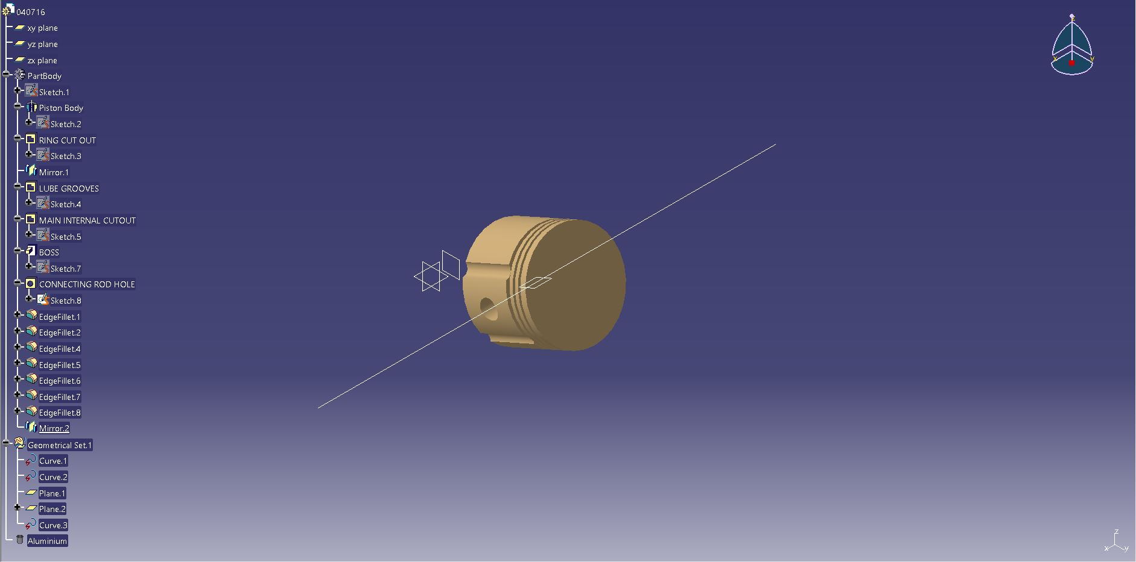
040716

Slide 36
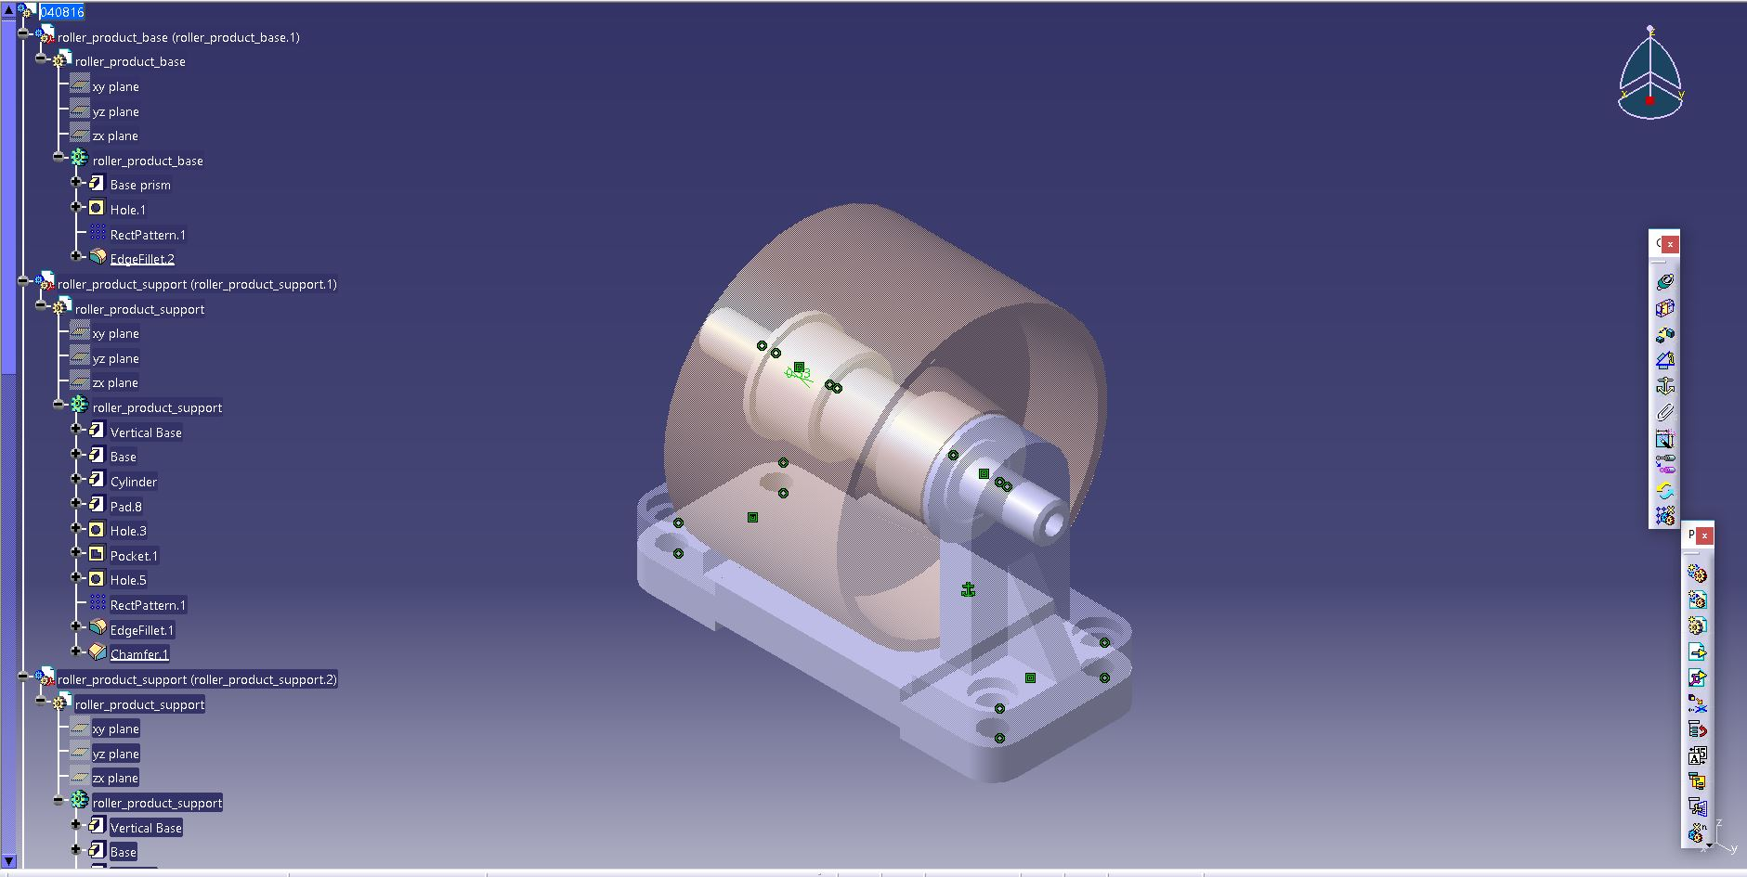
040816

Slide 37
040916

Slide 38
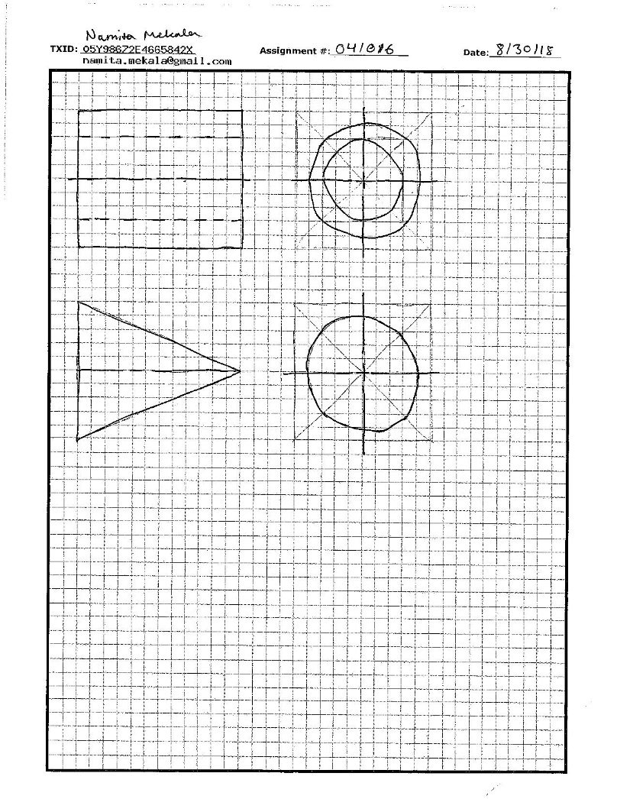
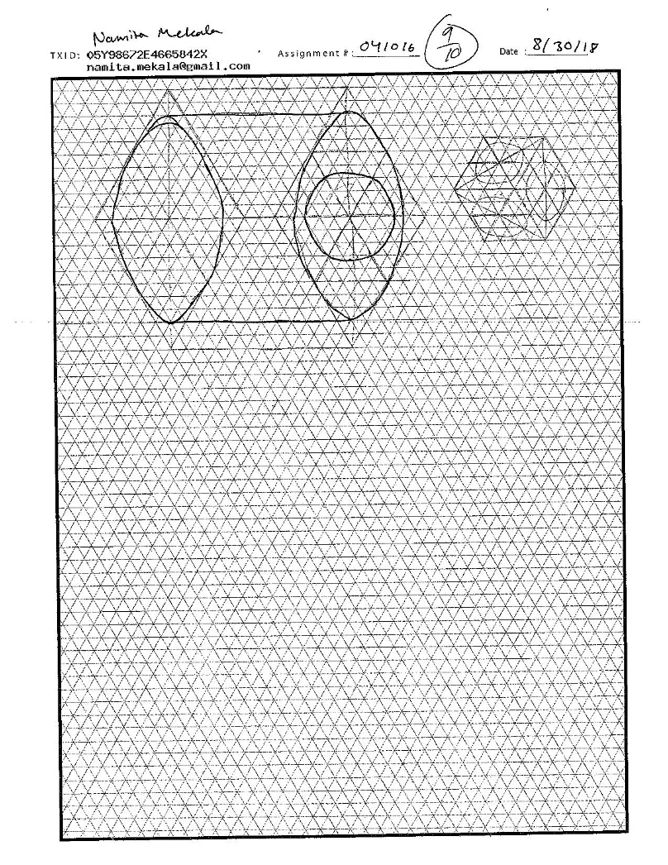
041016

Slide 39
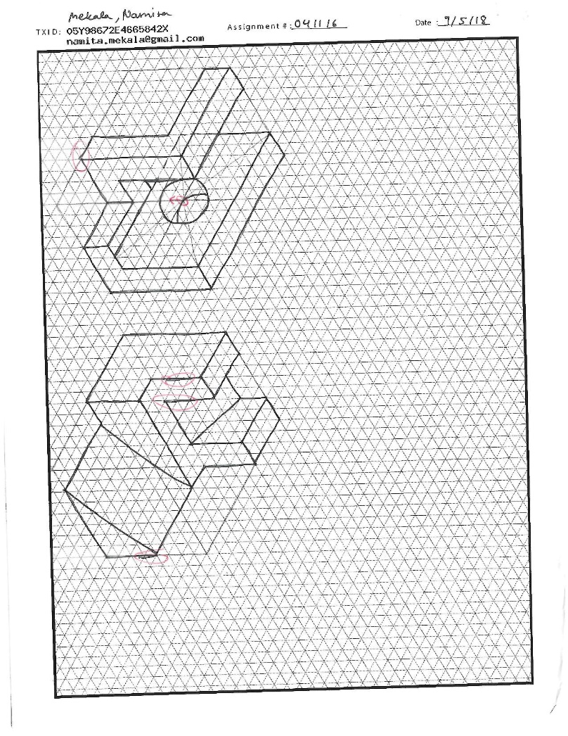
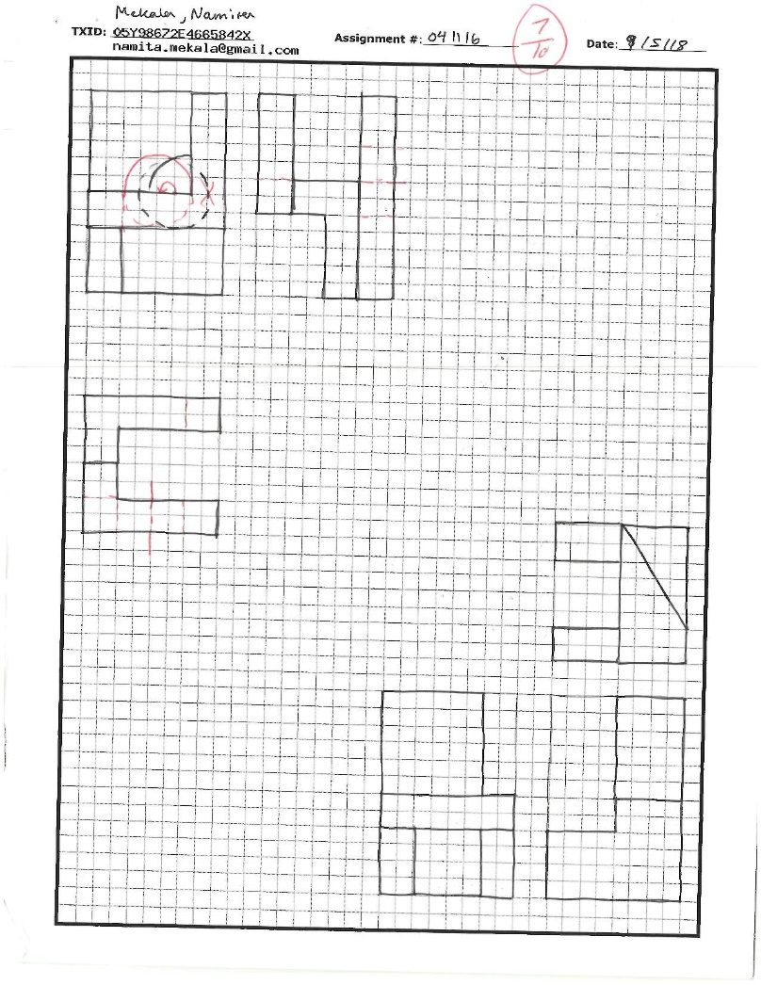
041116

Slide 40
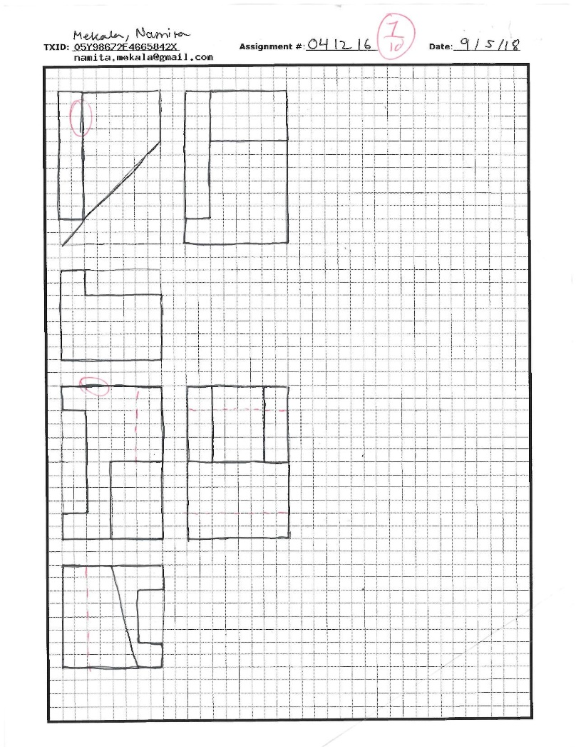
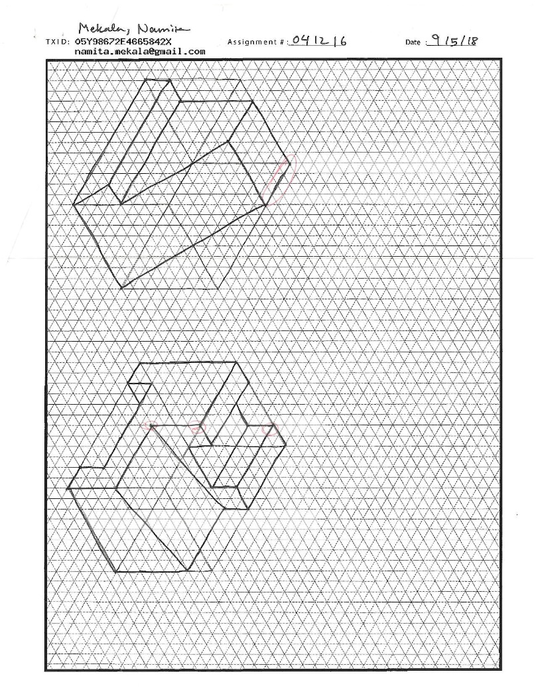
041216

Slide 41
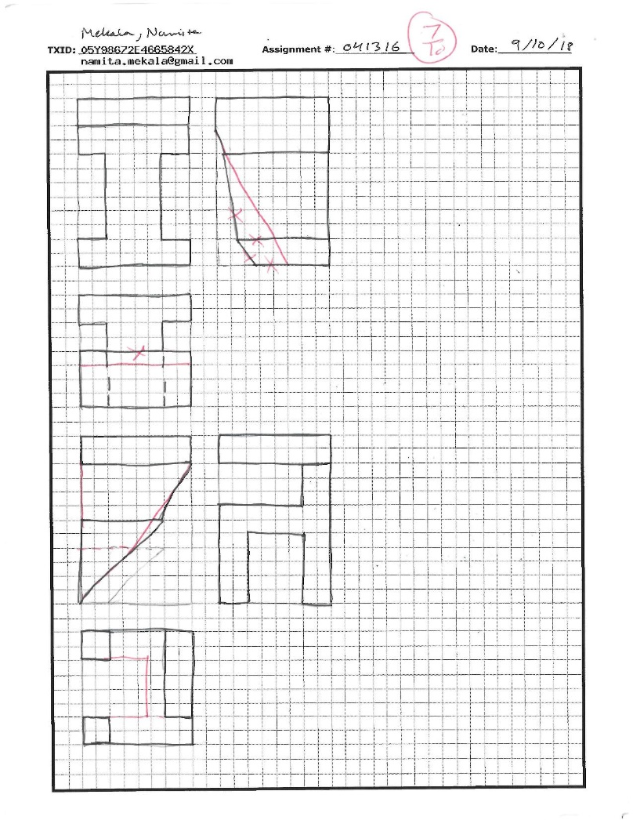
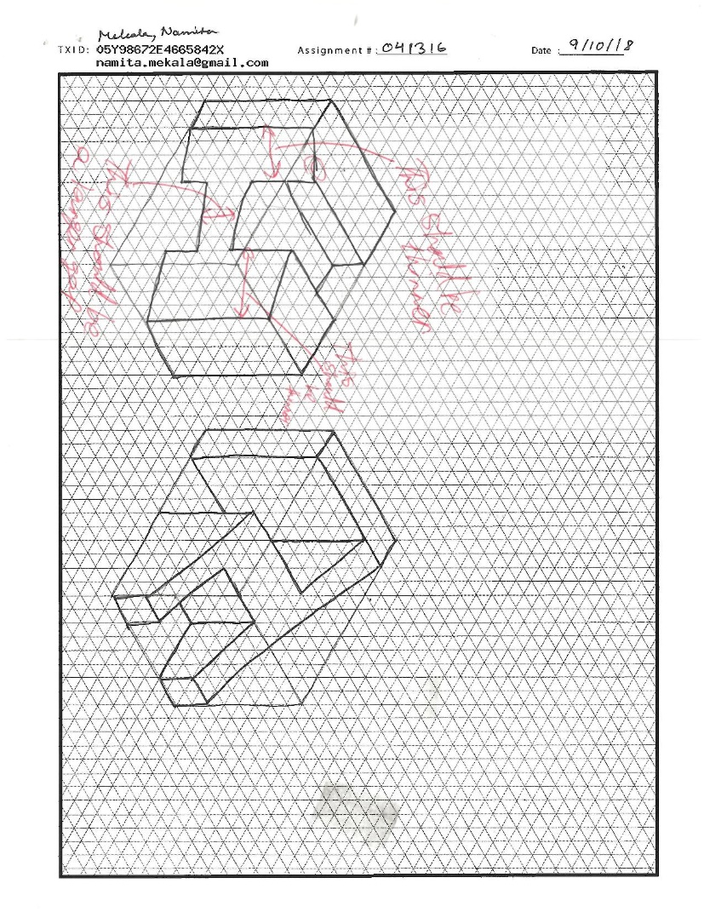
041316

Slide 42
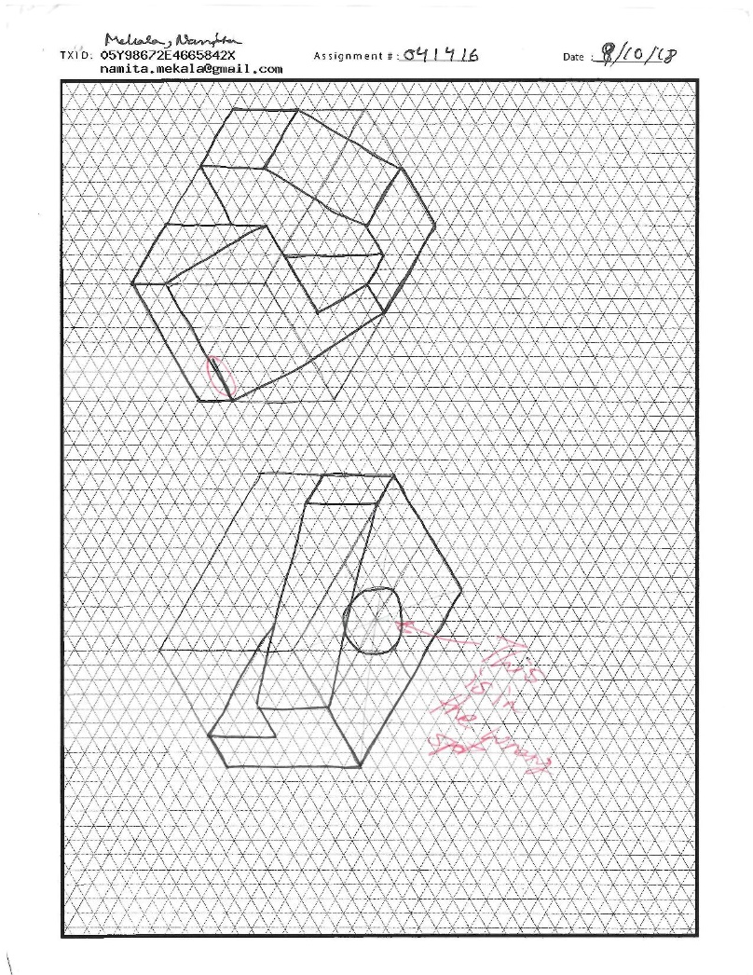
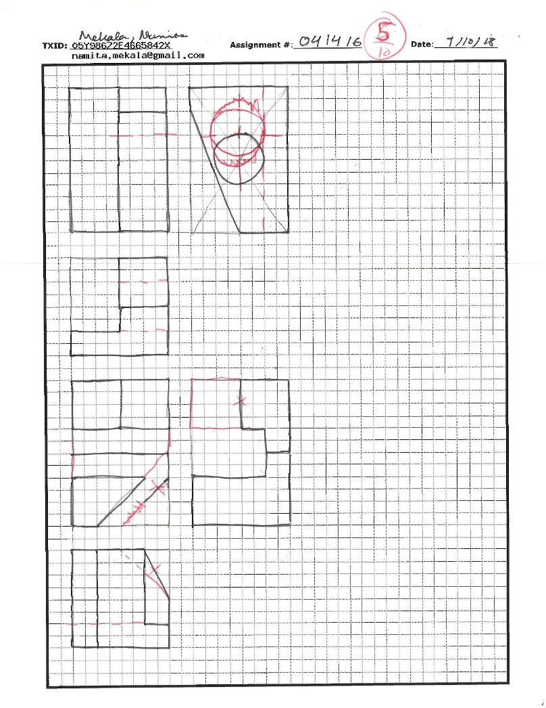
041416

Slide 43
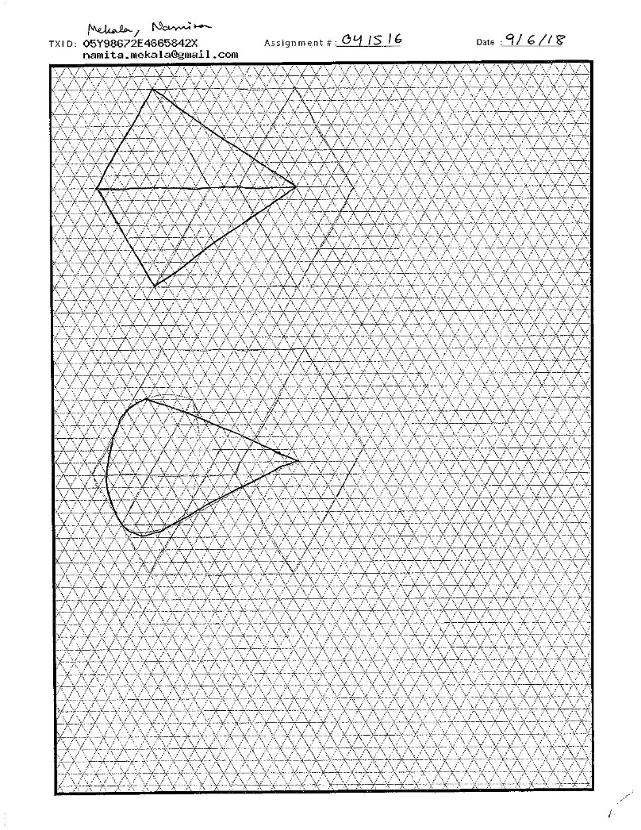

041516

Slide 44

041616

Slide 45

041716

Slide 46


041816

Slide 47

041916

Slide 48

042016

Slide 49

042116

Slide 50


042216

Slide 51

042316

Slide 52

042416

Slide 53

042516

Slide 54

042616

Slide 55


042716

Slide 56

042816

Slide 57

042916

Slide 58

043016

Slide 59

043116

Slide 60


043216

Slide 61


043316

Slide 62


043416

Slide 63


043516

Slide 64

043616

Slide 65

043716

Slide 66


043816

Slide 67

043916

Slide 68

044016

Slide 69

044116

Slide 70


044216

Slide 71


044316

Slide 72


044416

Slide 73


044516

Slide 74

044616

Slide 75


044716

Slide 76

044816

Slide 77

044916

Slide 78

045016

Slide 79

045116

Slide 80

045216

Slide 81


045316

Slide 82
045416
N/A

Slide 83
045516
N/A

Slide 84

045616

Slide 85


045716

Slide 86

045816

Slide 87


045916

Slide 88
QUIZZES

Slide 89


04Q0116

Slide 90


04Q0216

Slide 91


04Q0316

Slide 92


04Q0416

Slide 93
FINAL PROJECT

Slide 94

04FP16

Slide 95

04FP1601

Slide 96

04FP1602

Slide 97

04FP1603

Slide 98

04FP1604

Slide 99

04FP1605

