Slide 1
Molecular emission from star forming regions
NAMITA MEKALA
BASIS Advisor:
Mr. Kevyn Adams
NASA Advisors:
Dr. Sean Colgan
Dr. Naseem Rangwala

Slide 2

Purpose and Goals
Purpose
  To characterize molecules from star forming regions
Goals
  To learn Python and understand general coding logic

Slide 3
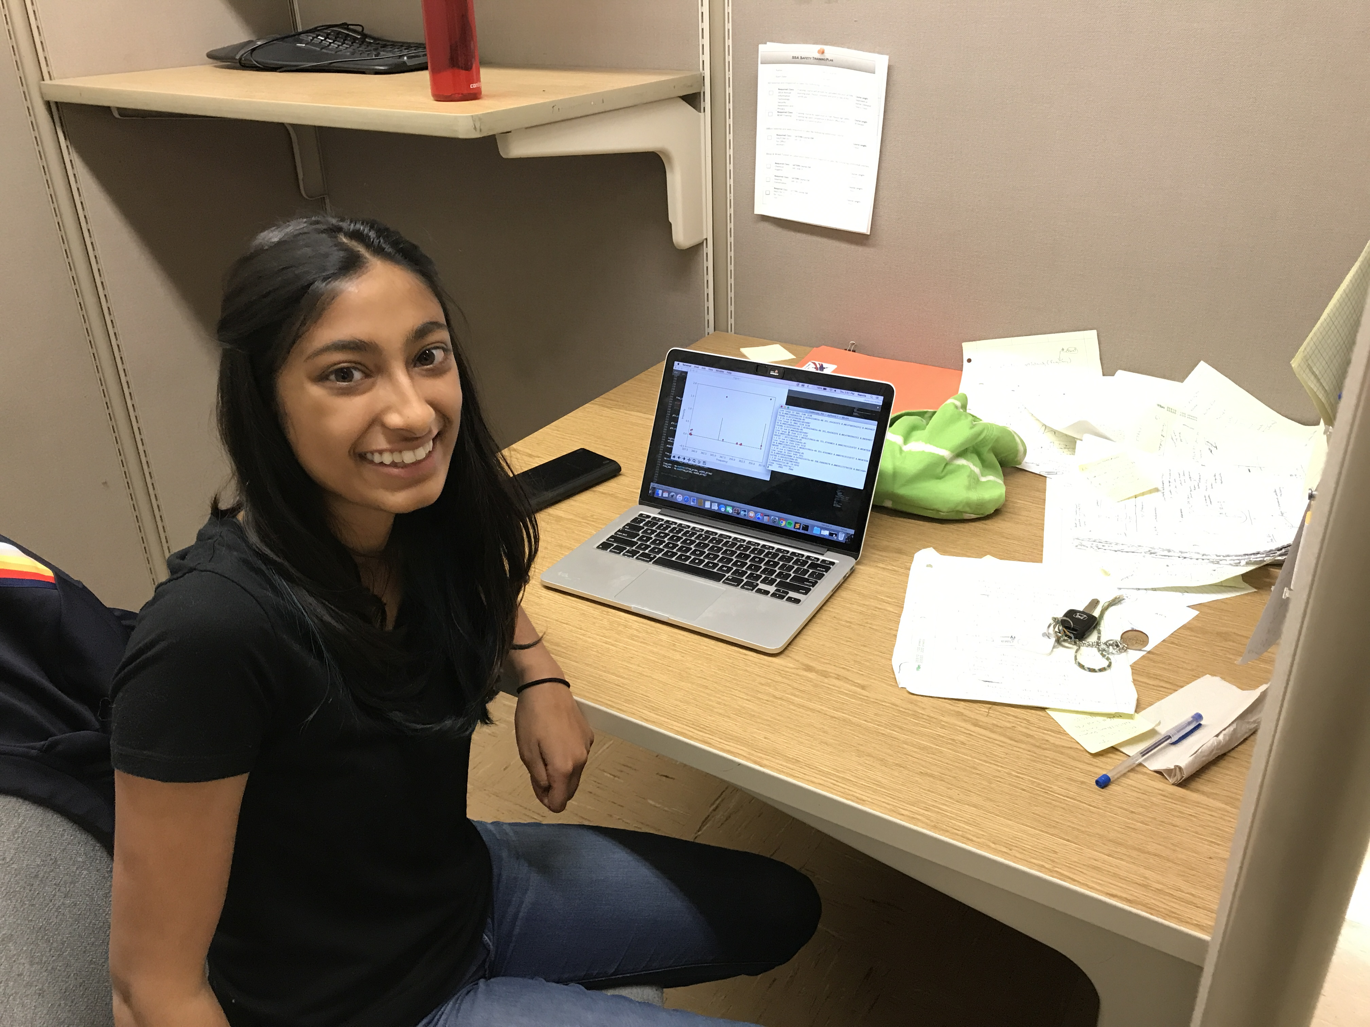
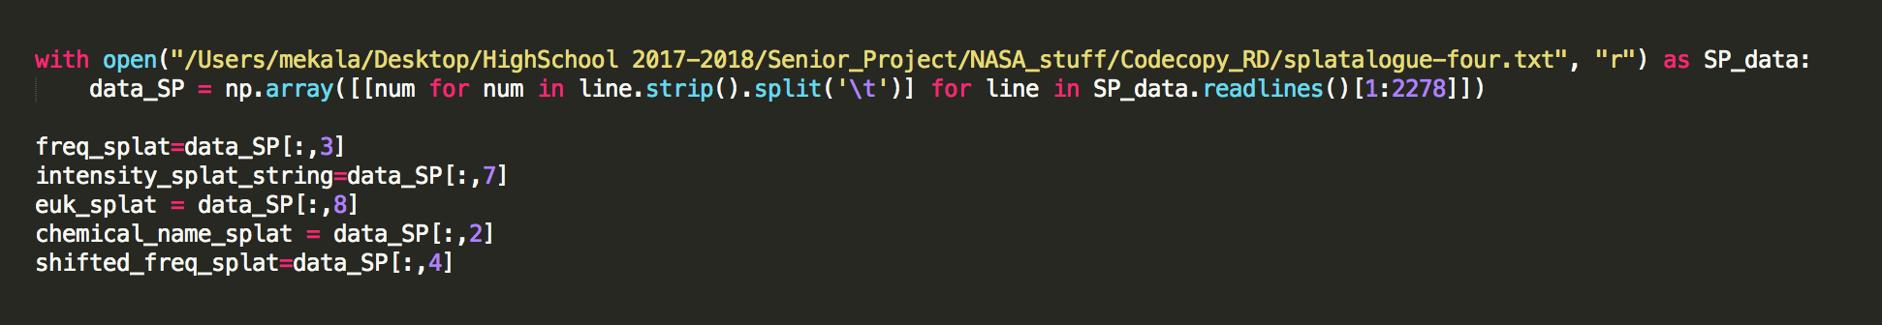
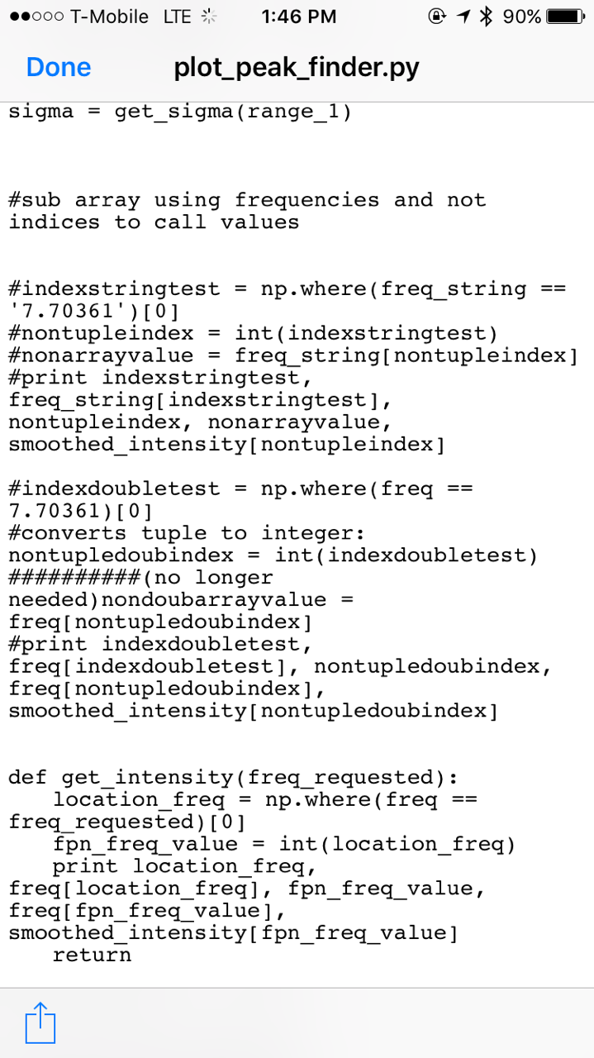
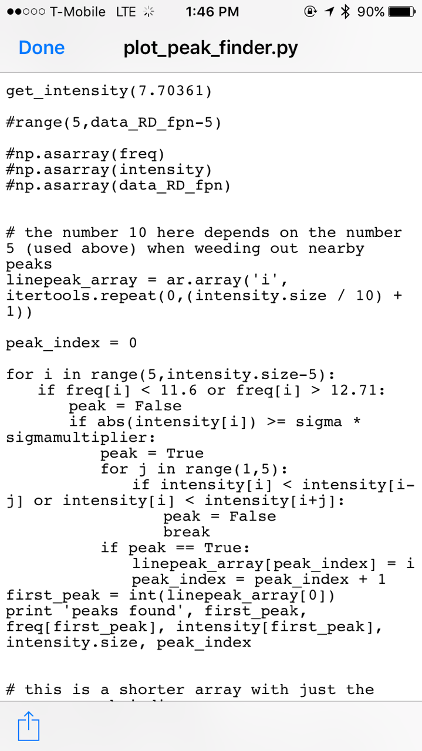
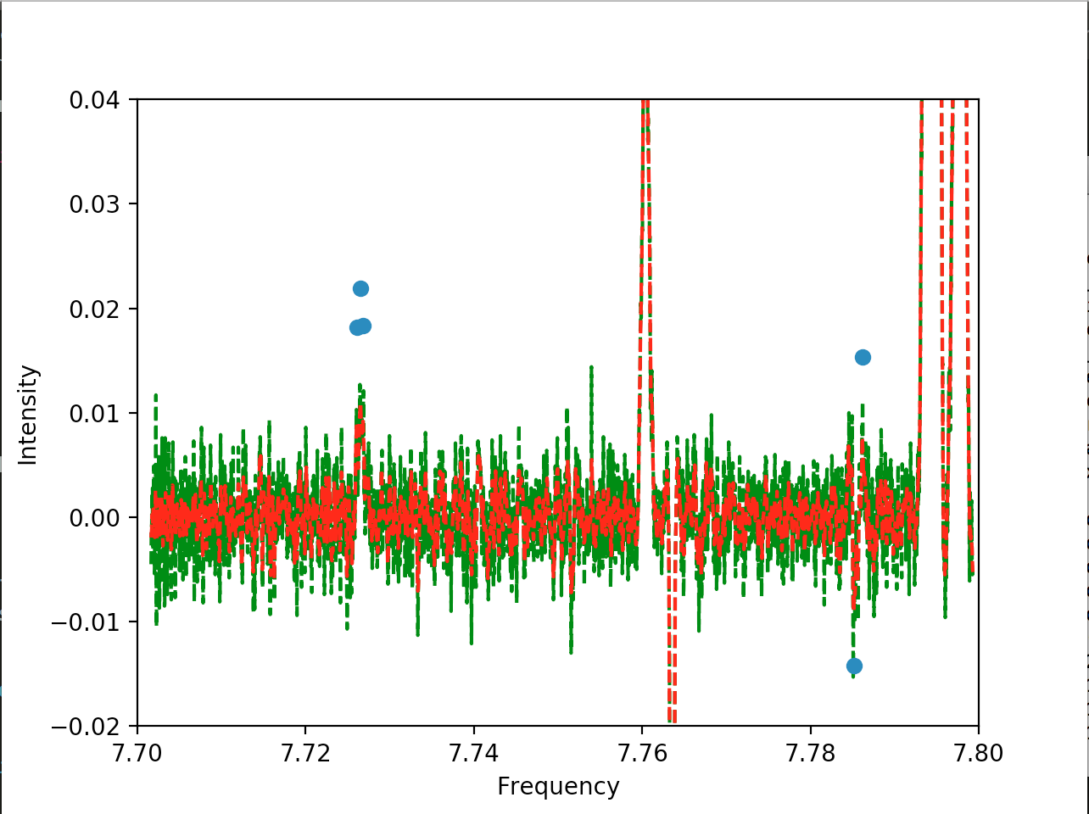
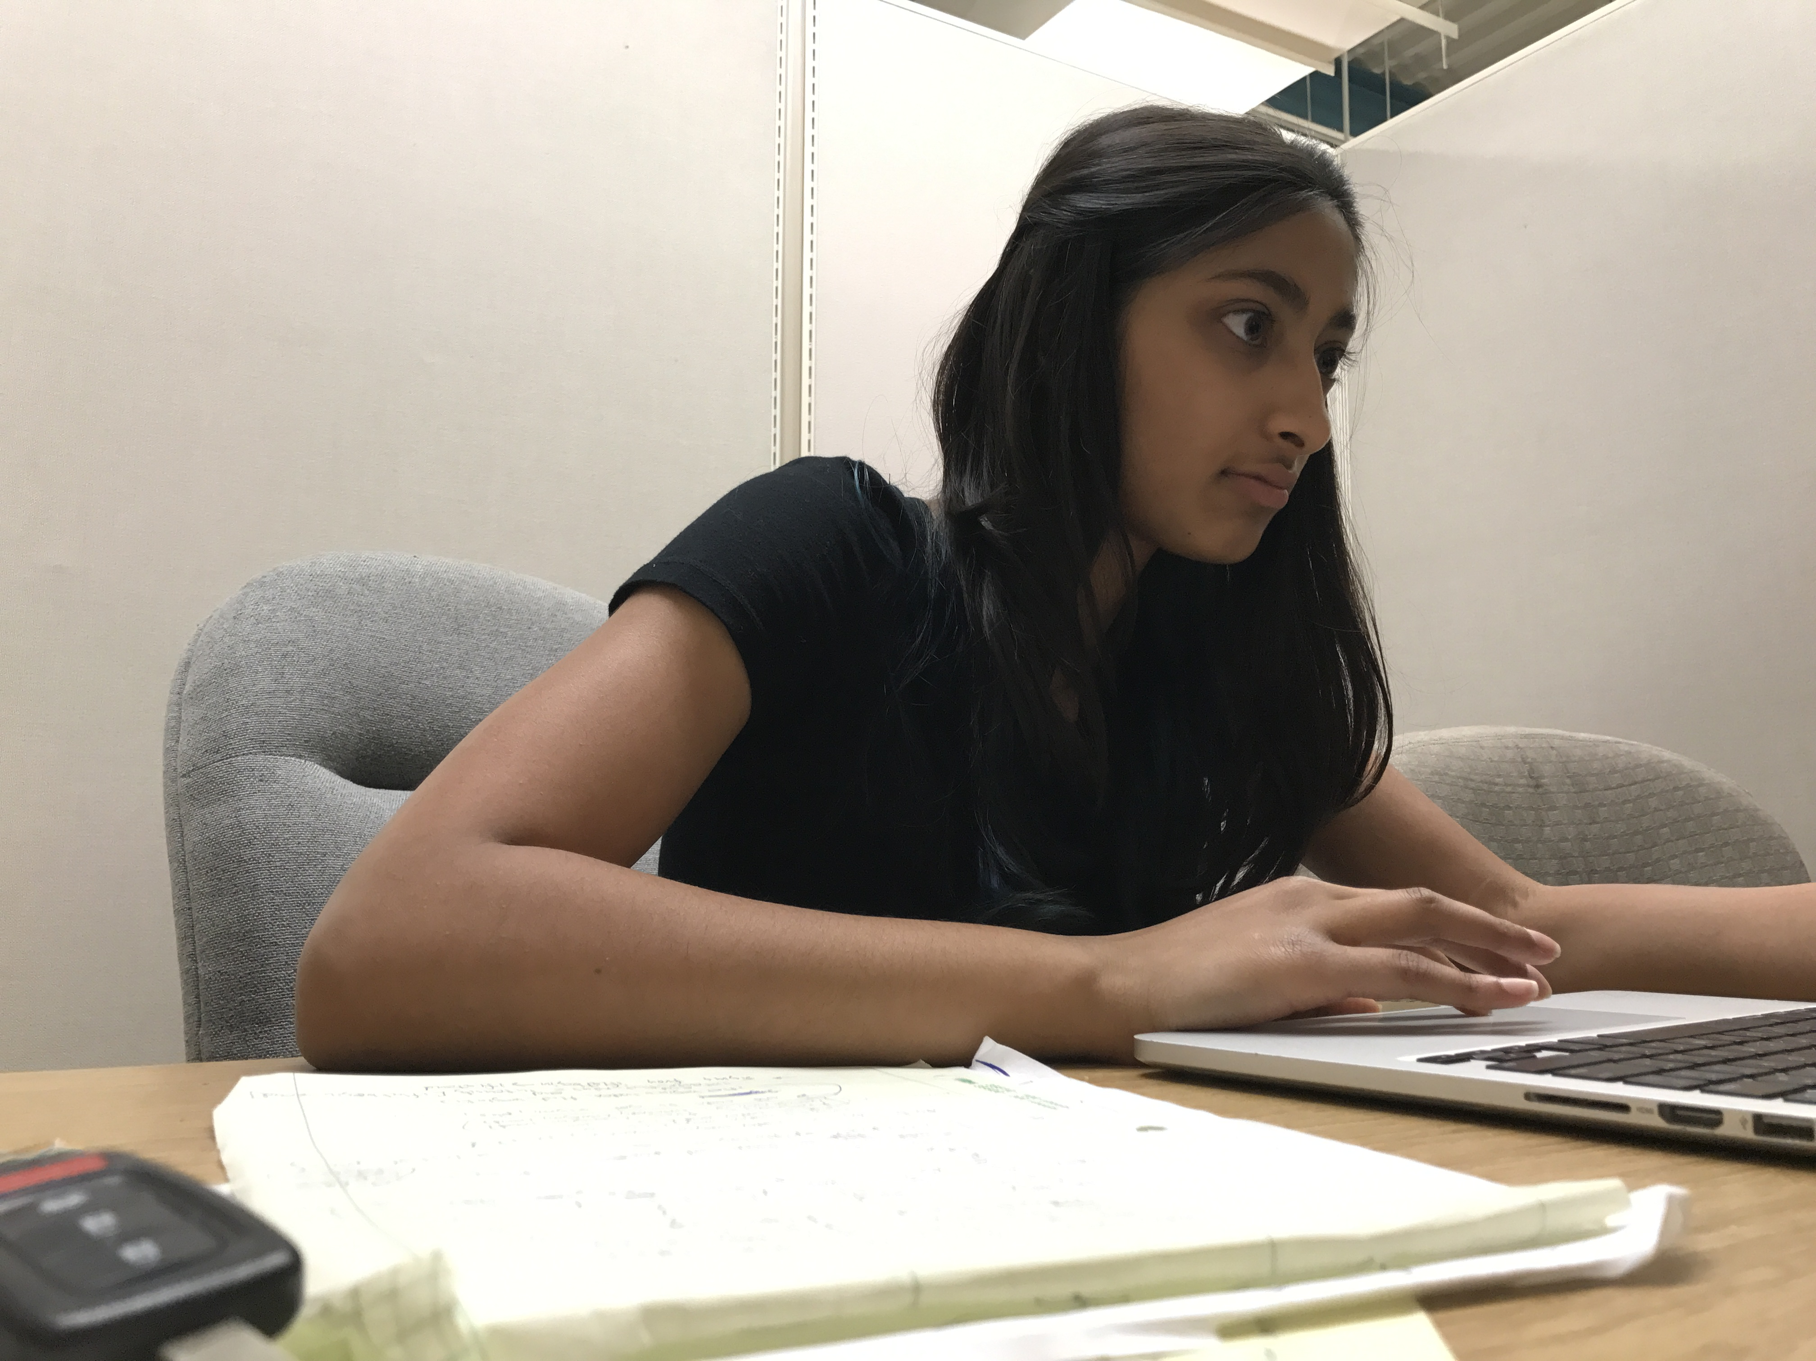
Day to Day

Slide 4
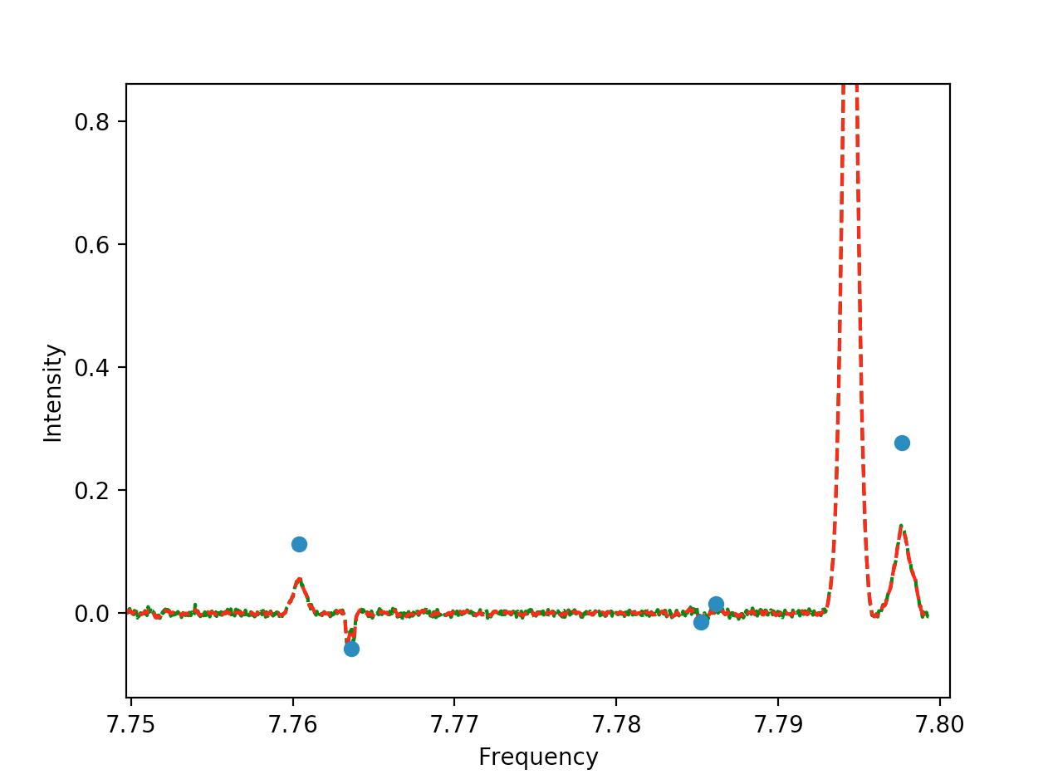
Context
Interstellar Medium
  74% Hydrogen
  25% Helium
  1% mostly unknown
Atacama Large Millimeter Array (ALMA)
  Interferometer
Molecular Line Surveys
Notes:
Alma is a telescope that uses interfeometry. Interformetry records radio waves. Astronomical images.
Fingerprints represents a key frequency of hydrogen.

Slide 5
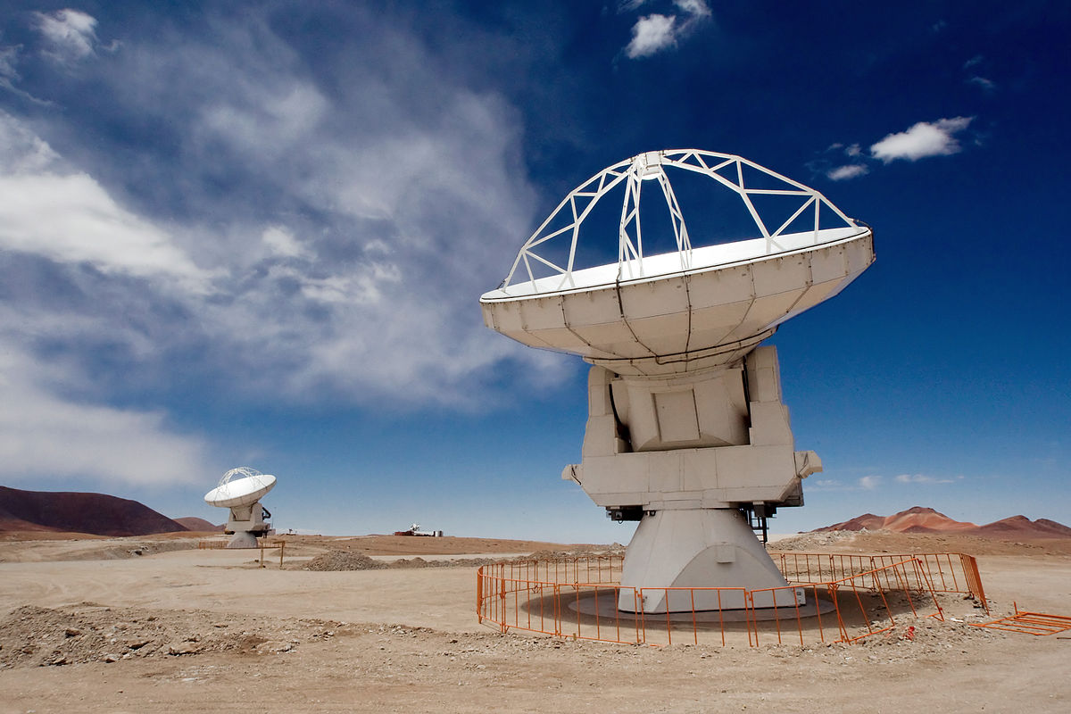
Notes:
Alma is a telescope that uses interfeometry. Interformetry records radio waves. Astronomical images.
Fingerprints represents a key frequency of hydrogen.

Slide 6
Context
Interstellar Medium
  74% Hydrogen
  25% Helium
  1% mostly unknown
Atacama Large Millimeter Array (ALMA)
  Interferometer
Molecular Line Surveys
Notes:
Alma is a telescope that uses interfeometry. Interformetry records radio waves. Astronomical images.
Fingerprints represents a key frequency of hydrogen.

Slide 7
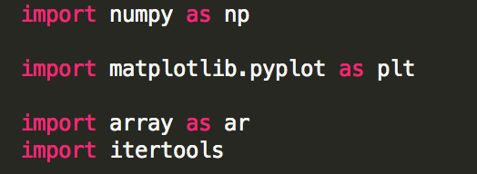
Project Journey
Python Course
  Udemy.com
Downloading Software
  CASA
Previous Intern’s Code
  Sgr B2(N)
  Translating code
ALMA Data
  Applying code
  Debugging
  Working with Splatalogue
Notes:
26,000 ly

Slide 8
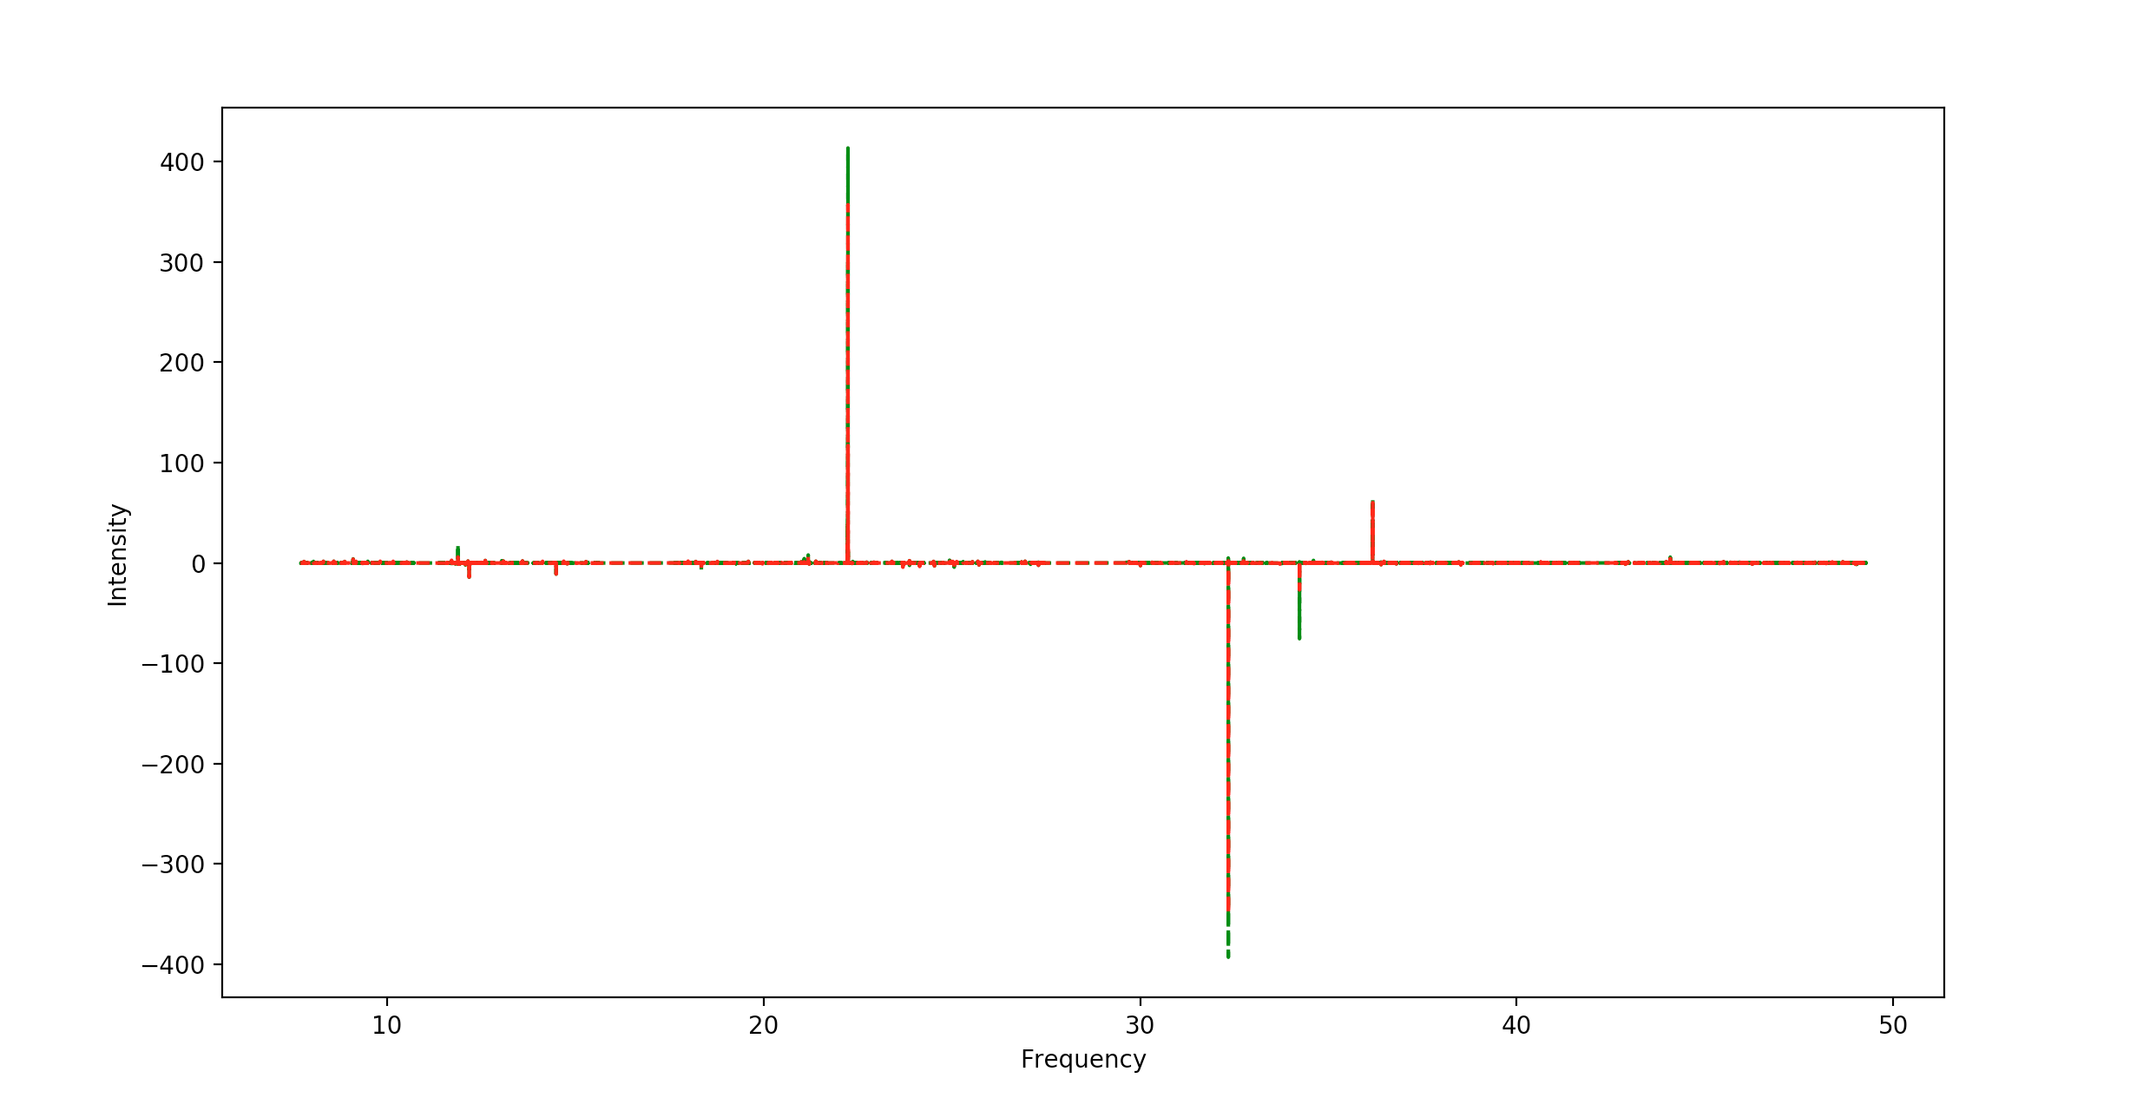
Process
Smoothing
  7
Noise Estimation
  Sigma
Evaluating the ranges
  Area, Frequency, and Width
Comparing Catalogues
  Splatalogue
Notes:
Sigma is a measurement of intensity. Values above it are significant

Slide 9
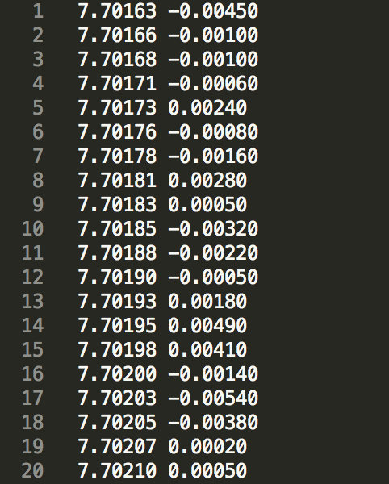
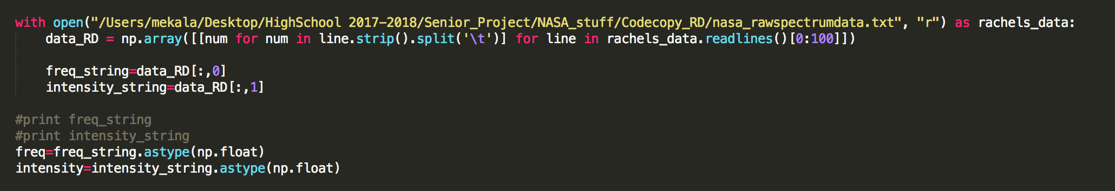
Data
Reading in the data and using libraries

Slide 10
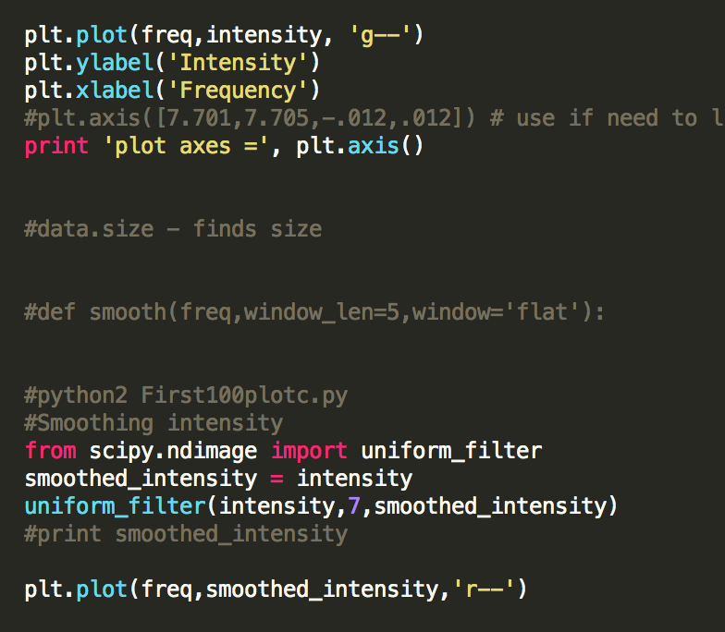
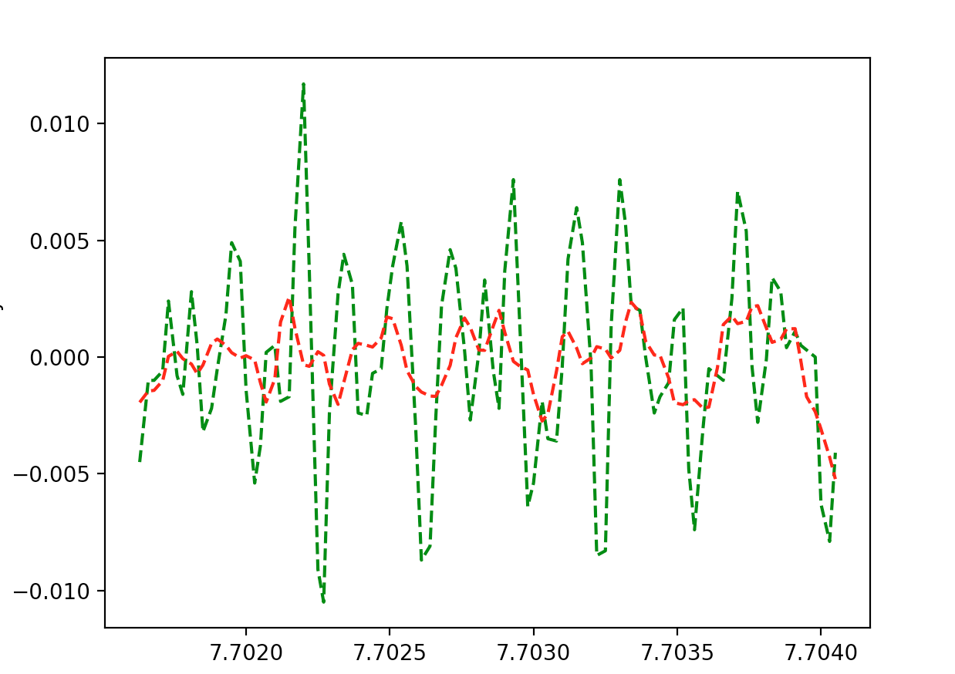
Plotting and smoothing
Averaging over 7 points and plotting the original and smoothed data
Notes:
Visual overlay of green and red lines

Slide 11
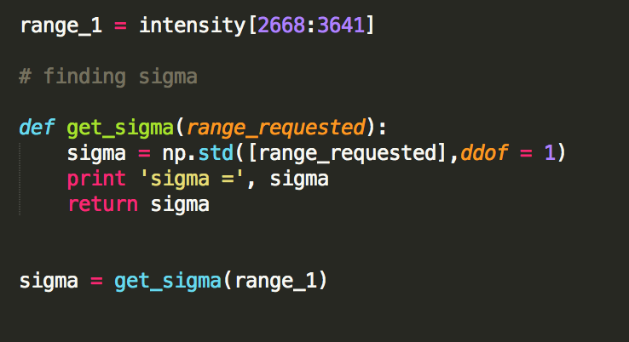
Noise Estimation
Solving for Sigma

Slide 12
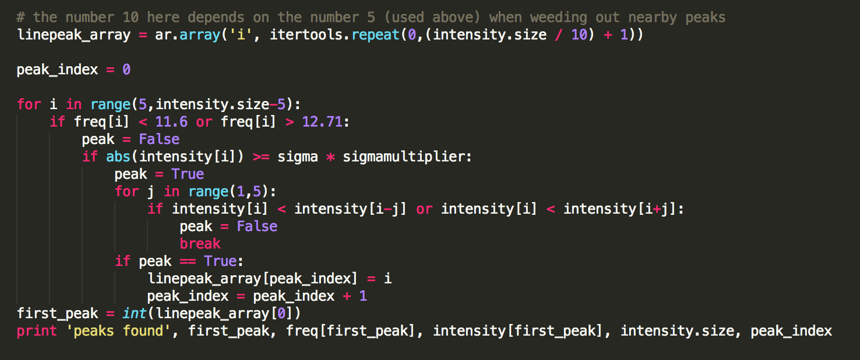
Evaluating the ranges
Finding peaks

Slide 13
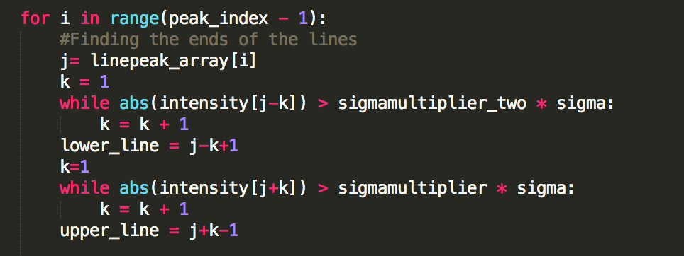
Evaluating the ranges
Finding the significant peaks

Slide 14
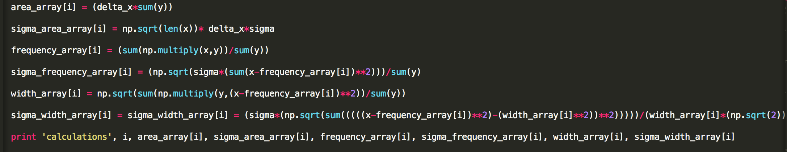
Evaluating the Ranges
Characterizing the peaks based on area, frequency, and width and the error bounds of these values
Notes:
Addd picture of equations.

Slide 15
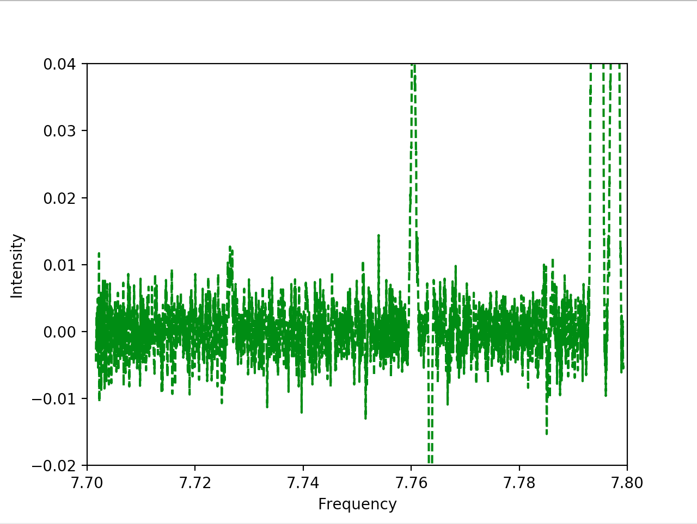
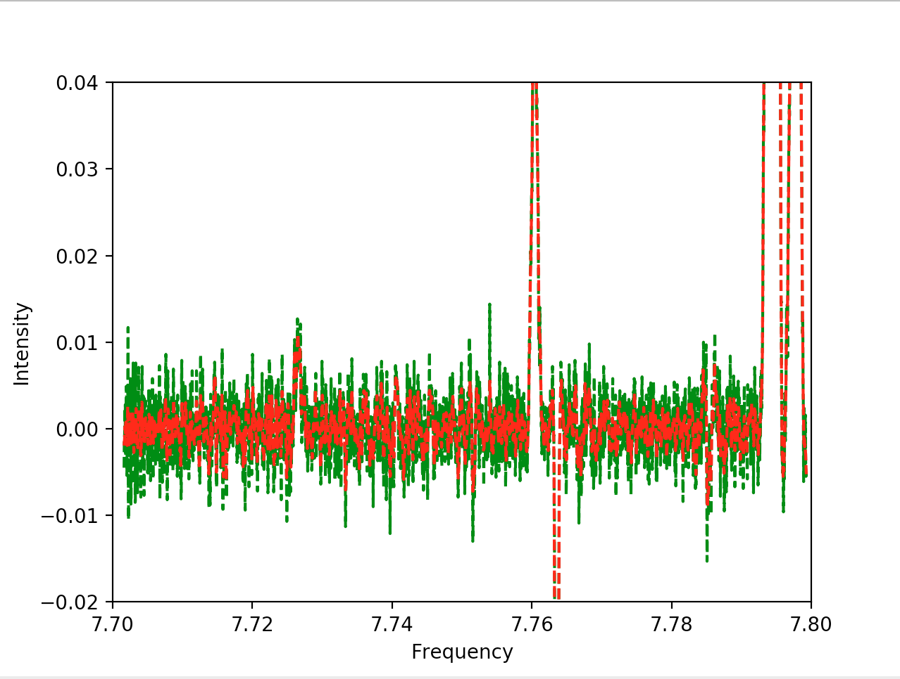
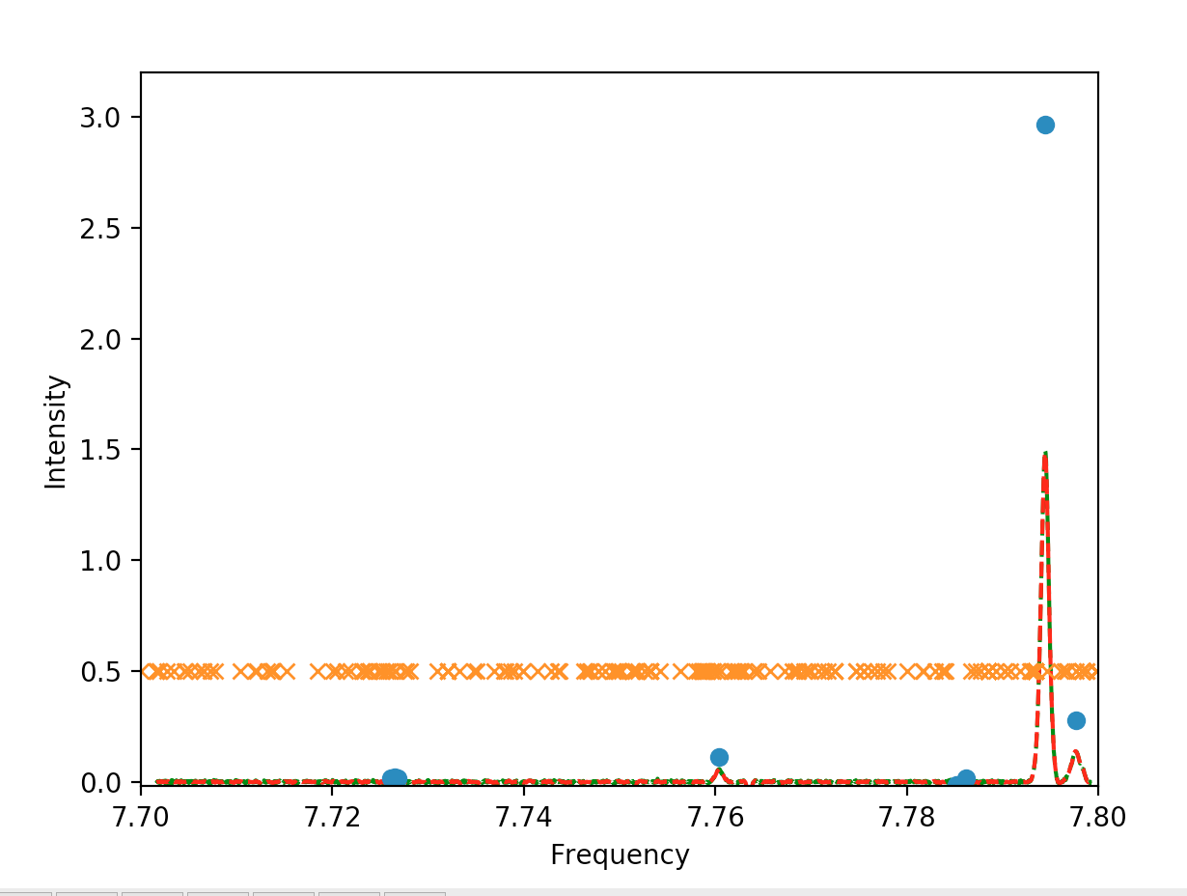

Slide 16
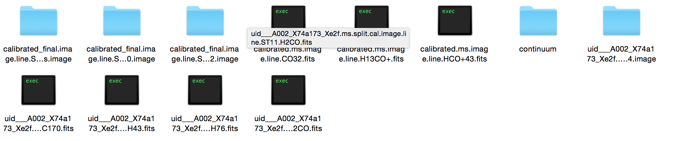
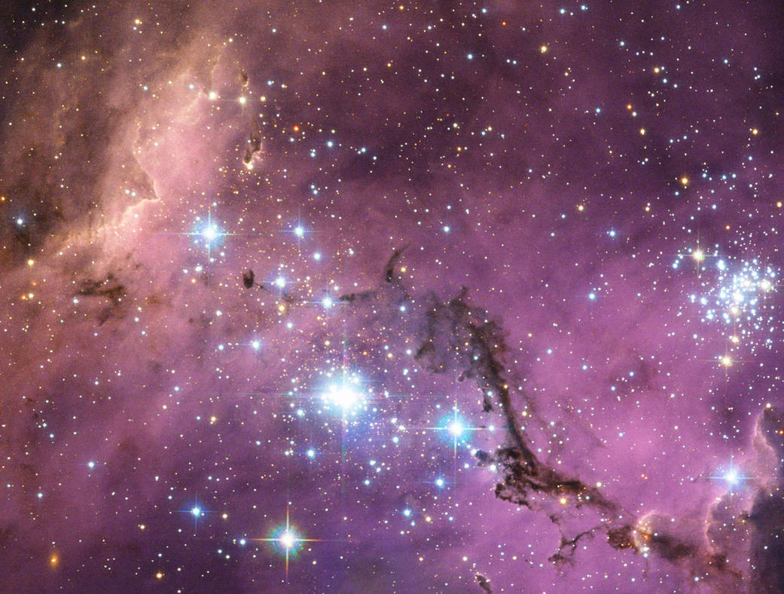
ALMA Data
FITS files – Flexible Image Transport System
Large Magellanic Cloud (LMC)
Notes:
163,000 ly away

Slide 17
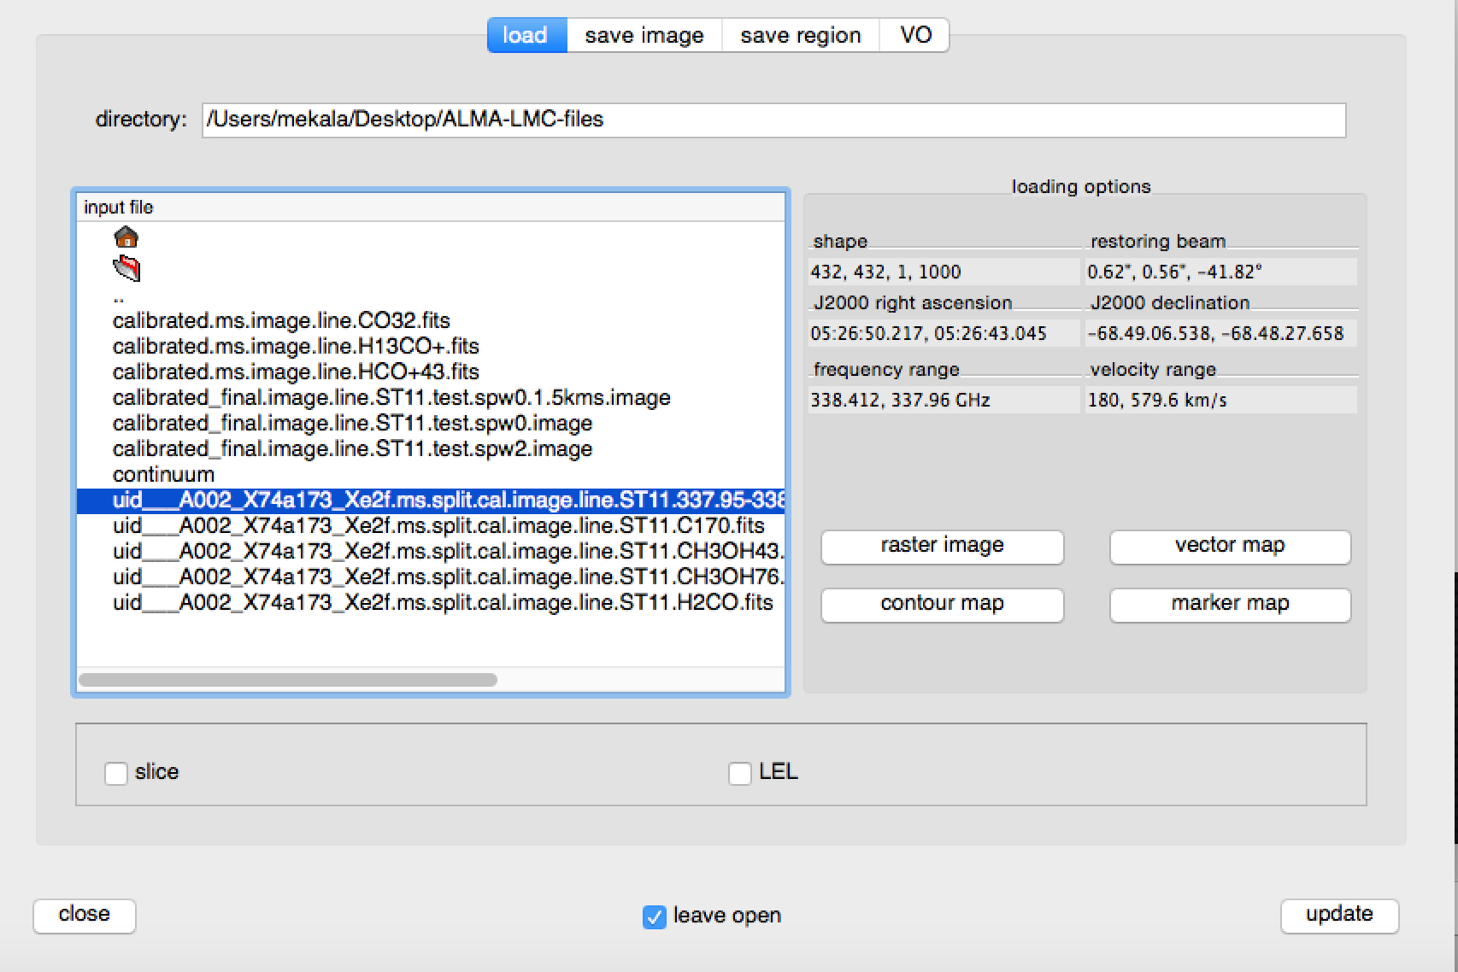
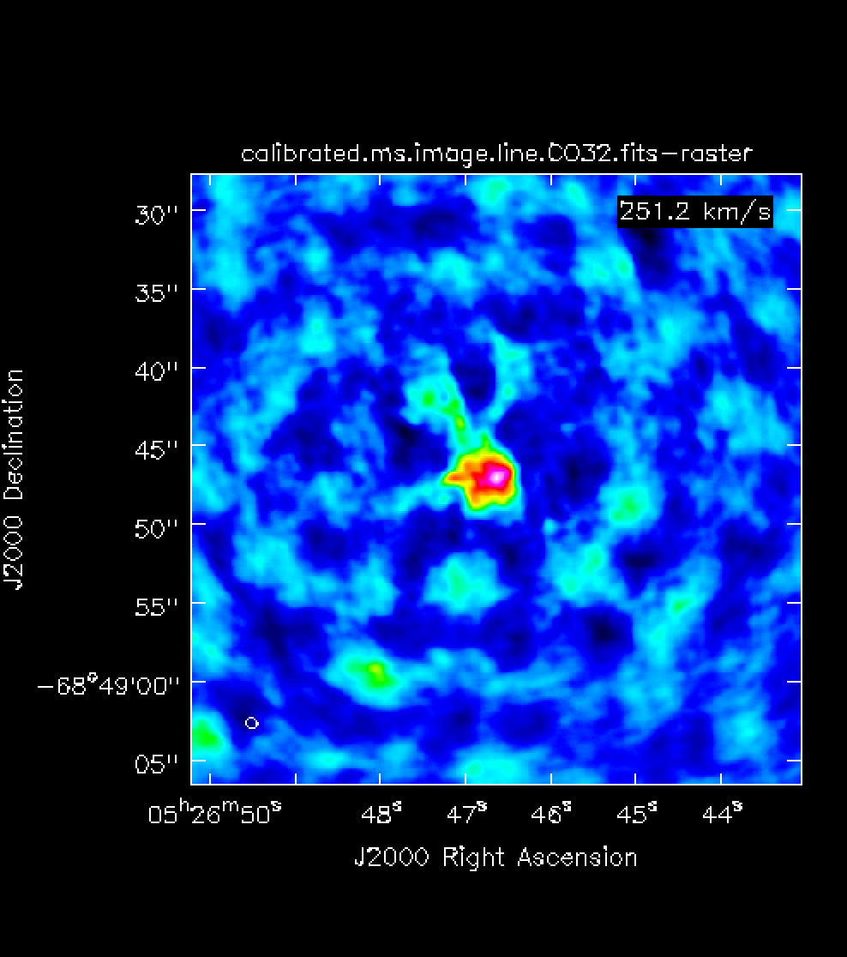
CASA - Common Astronomy software Applications
Data Processing

Slide 18
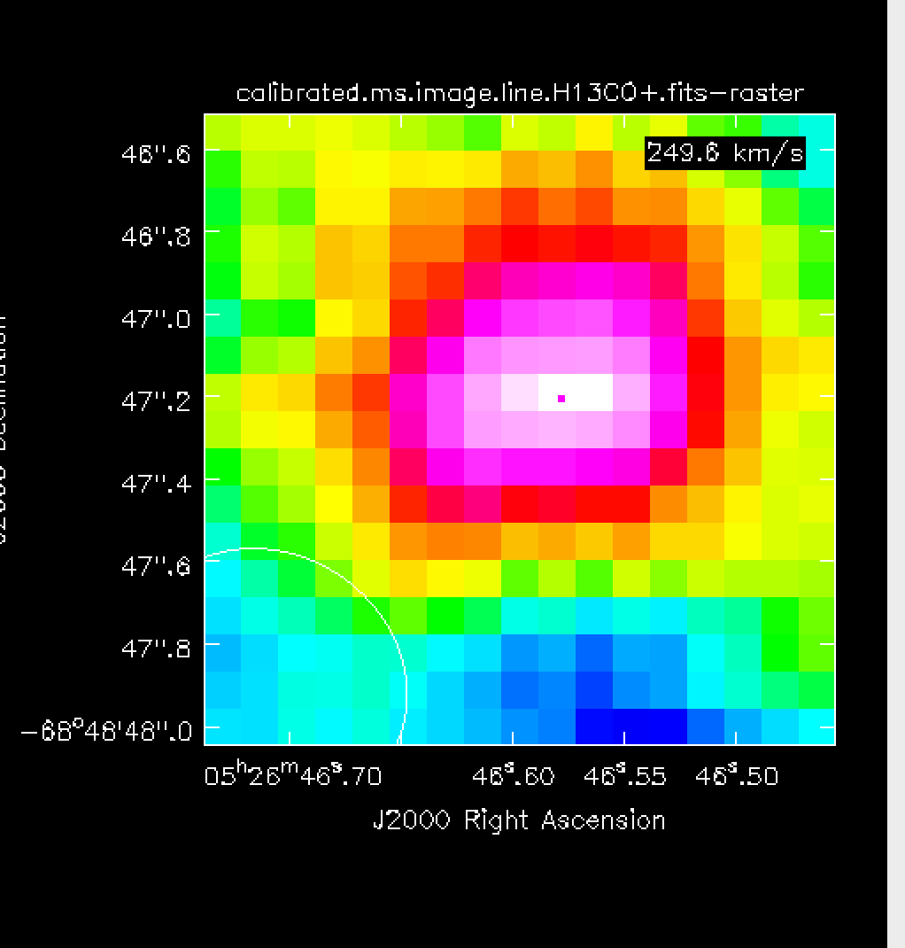
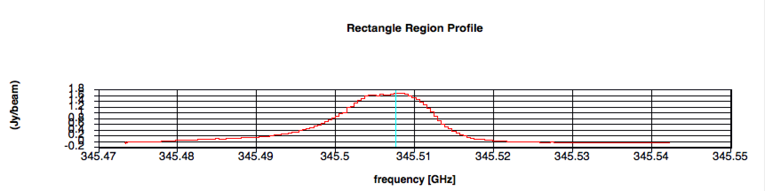
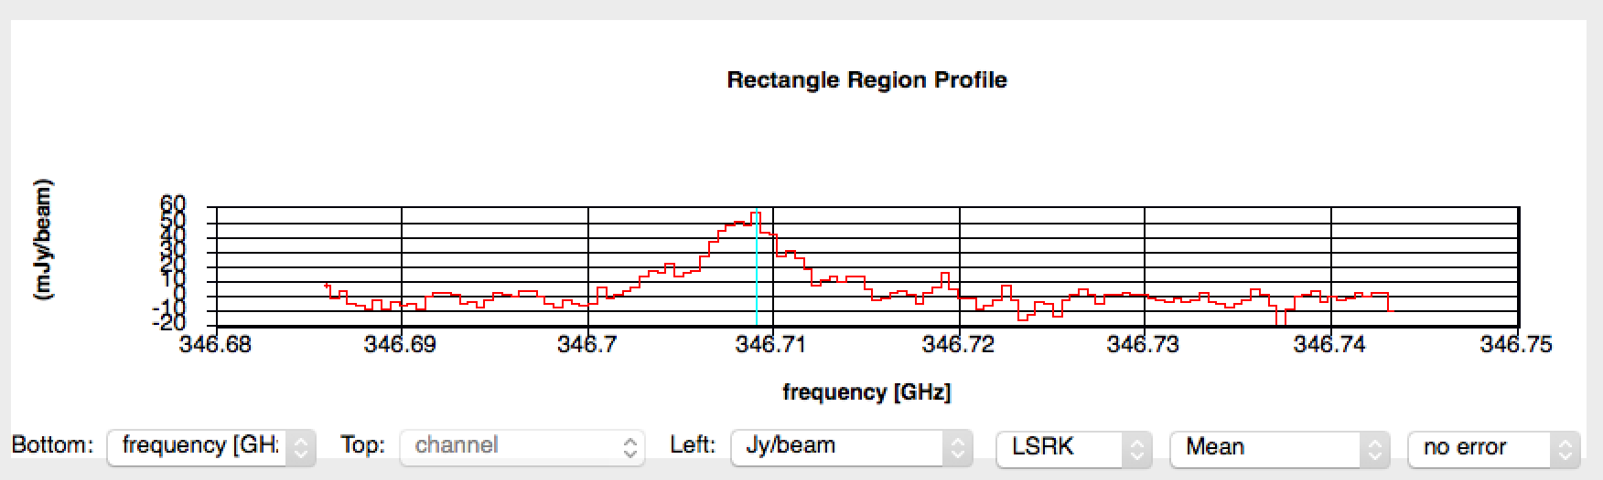
CASA

Slide 19
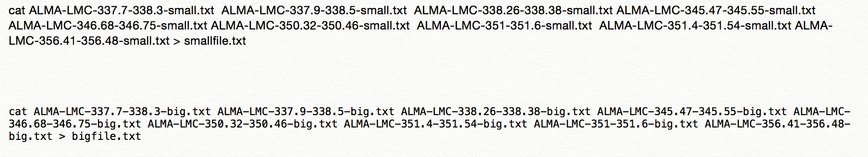
Saving and combining files

Slide 20
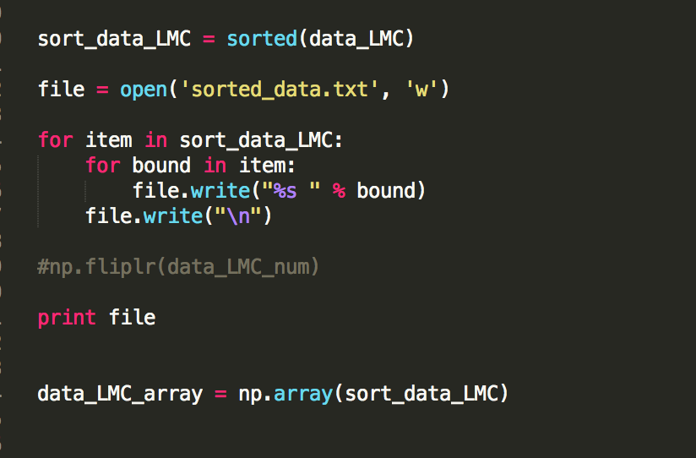
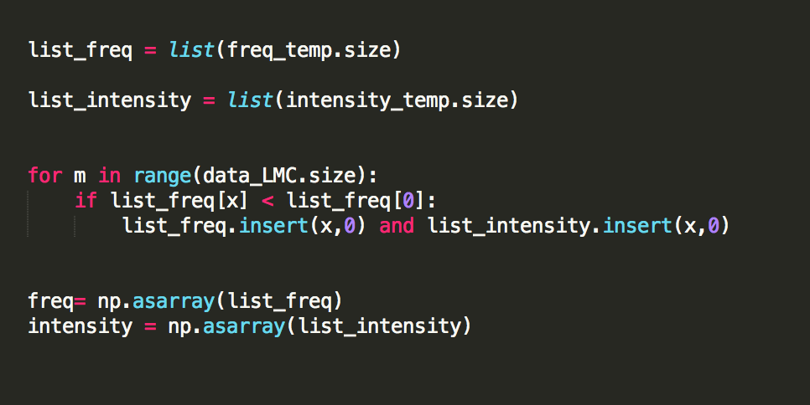
Sorting data
For loop Sort command

Slide 21
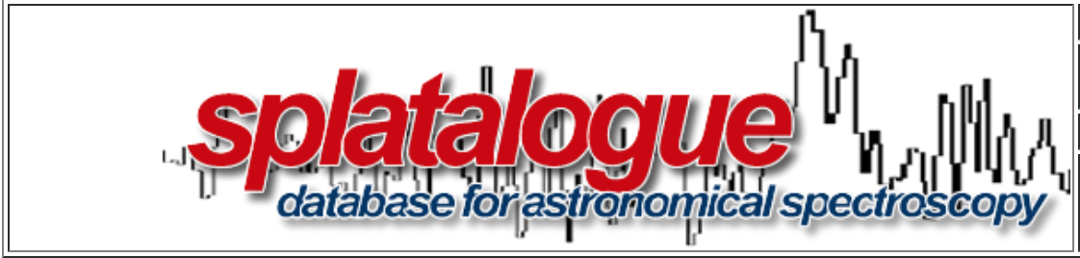
Comparing Catalogues
Comparing lines and using Splatalogue
Notes:
Add the timeline with plots.
Collecting data set – I chose X number of molecules and that’s the number we are evaluating.

Slide 22
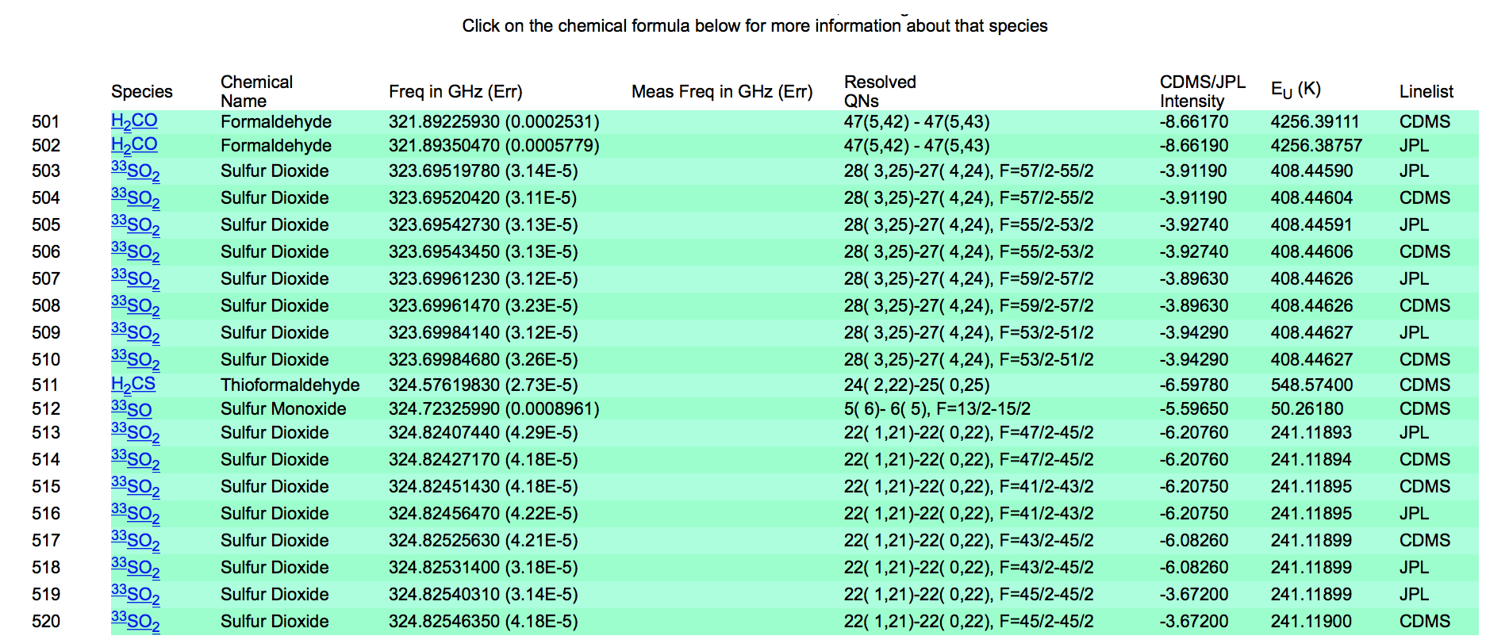
DowNloading from Splatalogue
What to download?

Slide 23
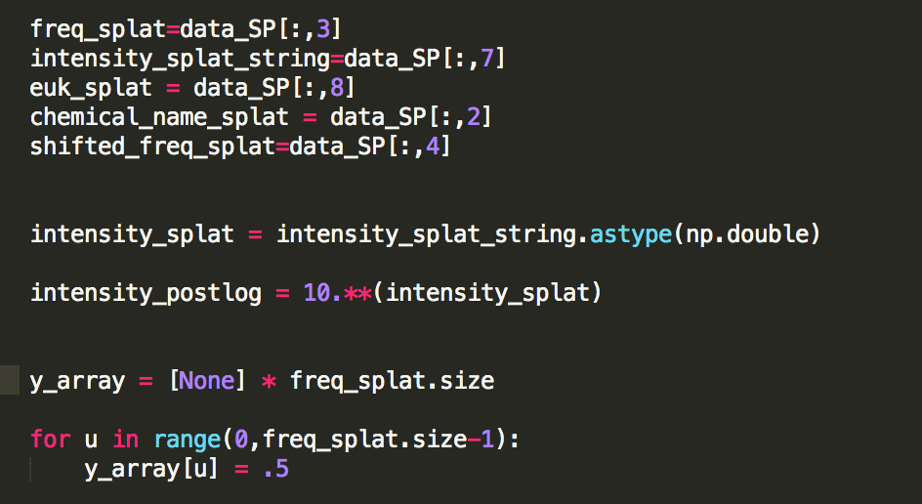
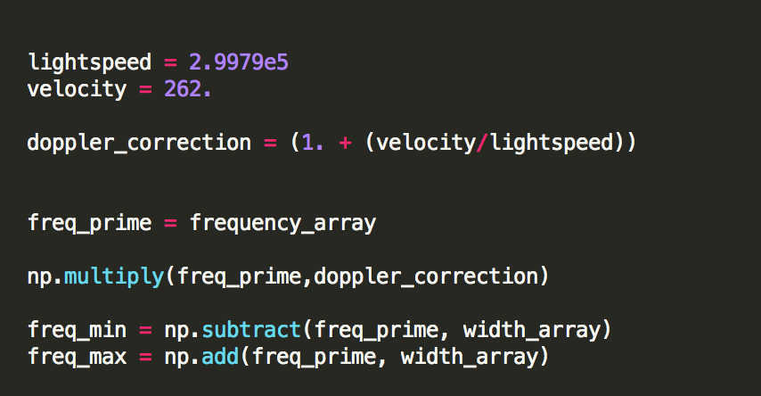
Splatalogue data code

Slide 24
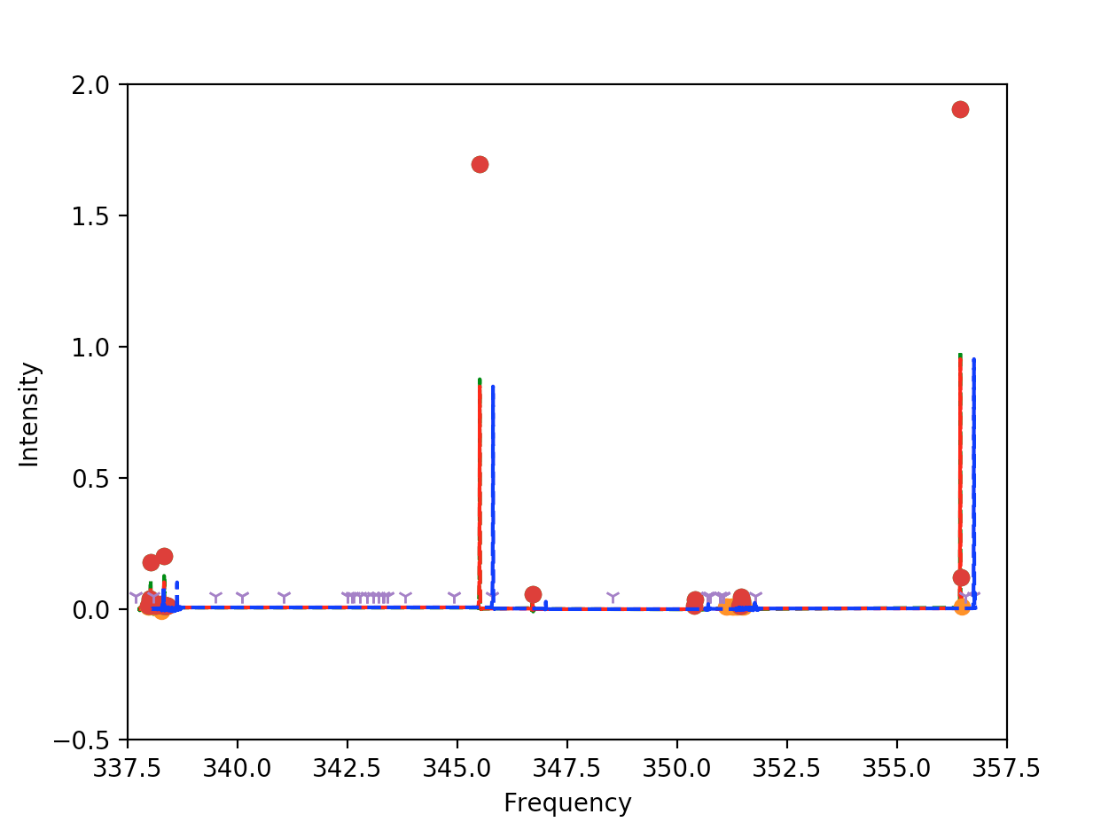
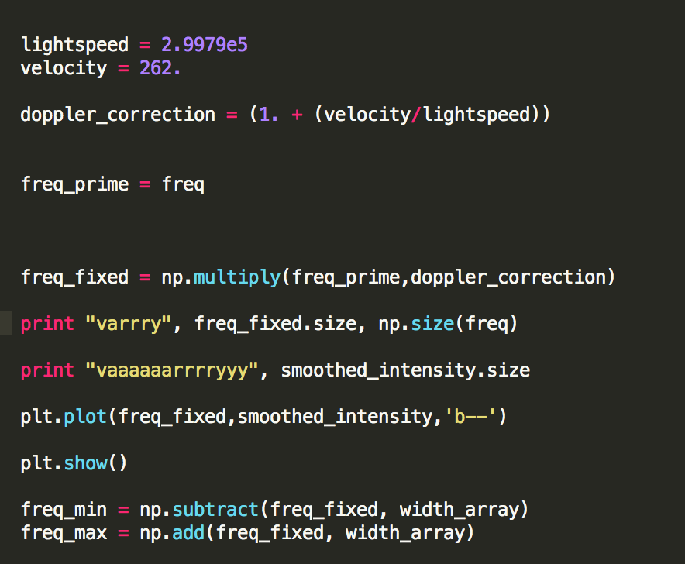
Doppler Correction and plot

Slide 25
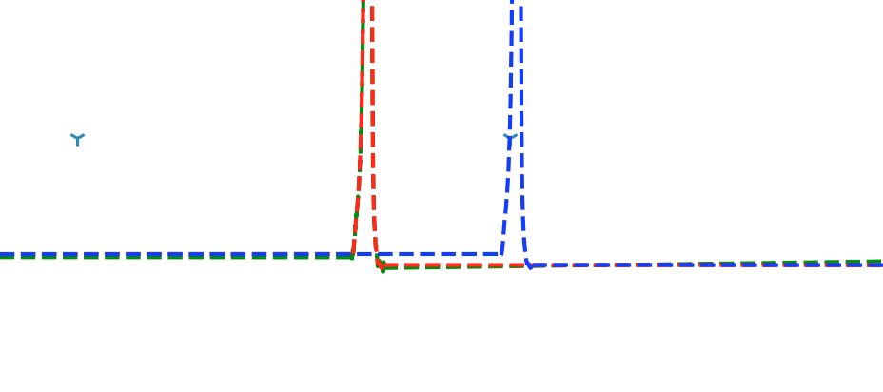
Findings

Slide 26
Challenges and Learnings
Simple coding Logic
  Plotting strings
  Absolute Value
Collaboration
Trial and Error

Slide 27
Significance
Understanding where specific molecules exist
Asking new questions

